Slide 1

Workexperience in
Northern Ireland
by
Felix Sobanski,
Tobias Timm,
Fabian Schorre

Slide 2
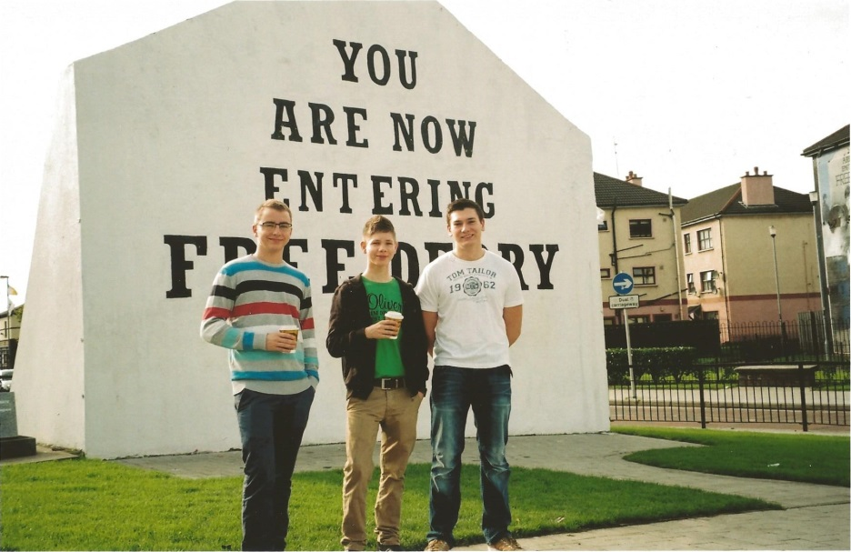
Contents
Introduction
Journey there
Derry / Londonderry
Trips around Derry
Sports activities
Workplaces
Journey home
Impressions and experiences

Slide 3
Introduction
We want to tell you something about our practical training in Northern Ireland.
Our teacher Mr. Ludwig Köster has invested so much time to make this trip to Ireland possible.

Slide 4
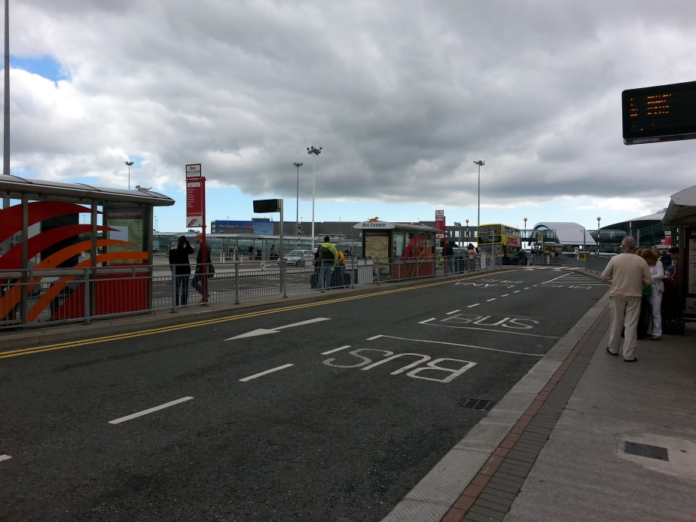
Journey there
25th of August, 2013
Journey start: 6 am
in Gummersbach
By car, plane and bus
Arrival: 5 pm in Derry

Slide 5
Workplaces

Slide 6
Workplace Tobias
I worked in the North West Regional College at the Information Services. In the office there were 6 technicians. They worked with a ticket system (HelpDesk). I checked and changed hardware, which was reported in a ticket.
Furthermore I prepared new working places and worked much with laptops. There were a lot of new laptops for the new students, which we prepared. We put an image on the laptops, configured them, included them into the network and stored them in charging stations. Also I had to install special software on some laptops for students or staff members.

Slide 7
Workplace Tobias
Then I had to make a new information website for the new WiFi. The design should fit the other websites of the North West Regional College and be compatible for mobile devices.
On the website you can get information how to connect to the WiFi on multiple devices and in which building, room and level is an access point or a WiFi signal. The information can also be easily updated by a text document.

Slide 8
Workplace Felix
I worked on a new website for the Business Support Centre of the North West Regional College.
The Business Support Centre gives young people the opportunity to start their own businesses.
My second work was to manage a database with over 5,000 entries.

Slide 9
Workplace Felix
In the second part of my traineeship I worked for the company „Blue Badge Guides“.
My employer was Michael Cooper and he showed me very much about the history of Northern Ireland.
My task was to use these information to program and design new websites e.g. of the new Gasyard Heritage Centre in Derry.

Slide 10
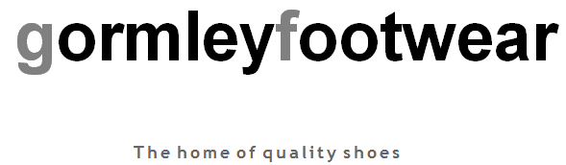
Workplace Fabian
The name of my workplace was Gormley Footwear.
It is a small company with three shop assistants.
This company is in the neighbour town of Derry called Strabane.
Gormley Footwear sells shoes and shoe equipment.
The company sells 50% online and 50% in the shop.

Slide 11
Workplace Fabian
At first I created a database for the customers of the shop.
I saved customer data in this database and managed them.
Moreover I improved the website of Gormley Footwear in regard to design and function.
Furthermore I programmed for each product an own site on ebay (230 sites).
Finally I gave support in saving data, operating systems and applications.

Slide 12
Workplace Fabian
Which languages did I use?
  HTML (Hypertext Markup Language)
  CSS (Cascading Style Sheets)
  Javascript
Which programming environment did I use?
  I used “Notepad++” for programming environment.

Slide 13
Derry / Londonderry

Slide 14
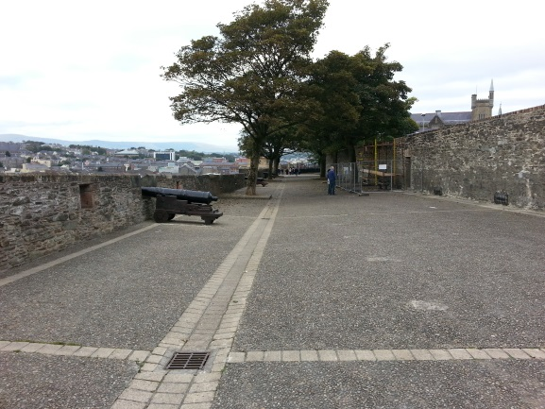
Derry / Londonderry - The City
Derry is the second largest city in Northern Ireland.
It has 111.000 inhabitants
Derry is also known as Londonderry and The Walled City.
In Londonderry was the origin of
the Northern Ireland conflict.
Derry was first mentioned in
the year 546.

Slide 15
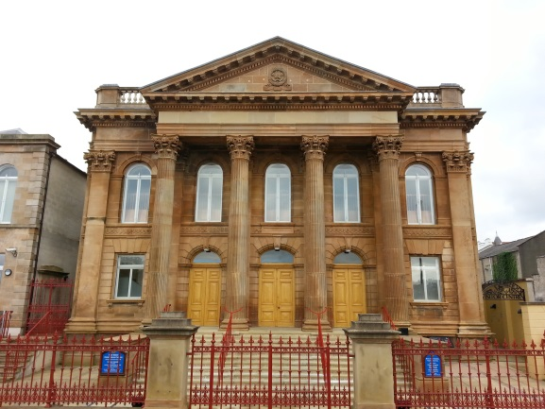
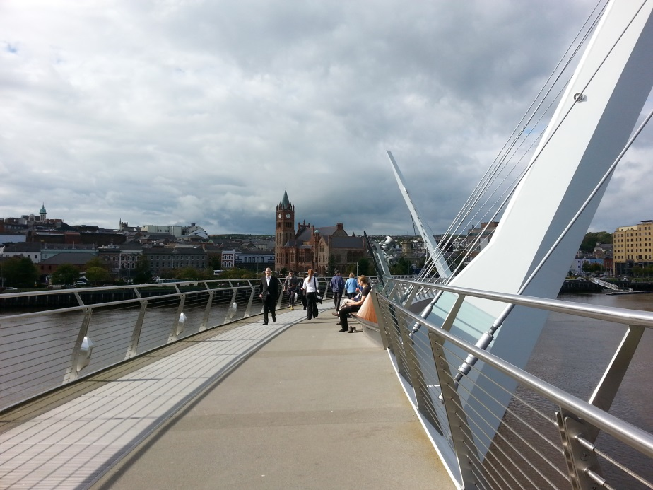
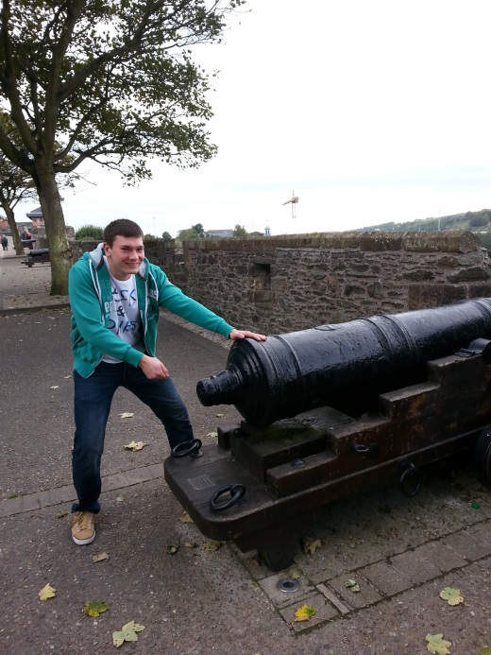
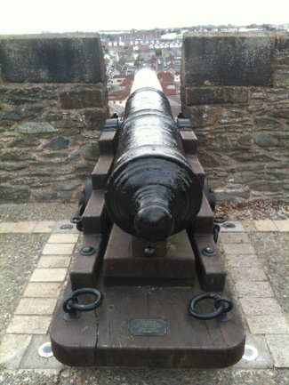
Londonderry - The City

Slide 16
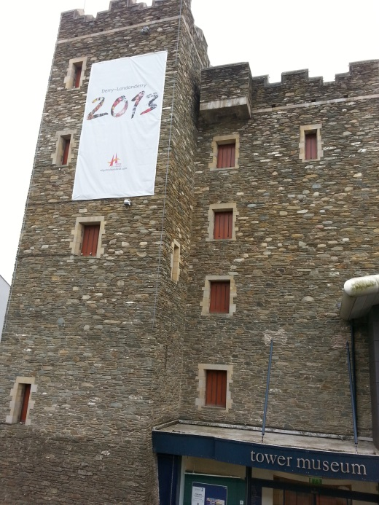
Culture and Tourism
The museum of Derry shows the conflict
of Northern Ireland against England.
The Bloody Sunday Monument in the
Bogside gives tribute to the innocently
killed people in 1972.
Derry has 400 year old city walls.
The Guildhall was the town hall of Derry,
and it shows the history of Derry.

Slide 17
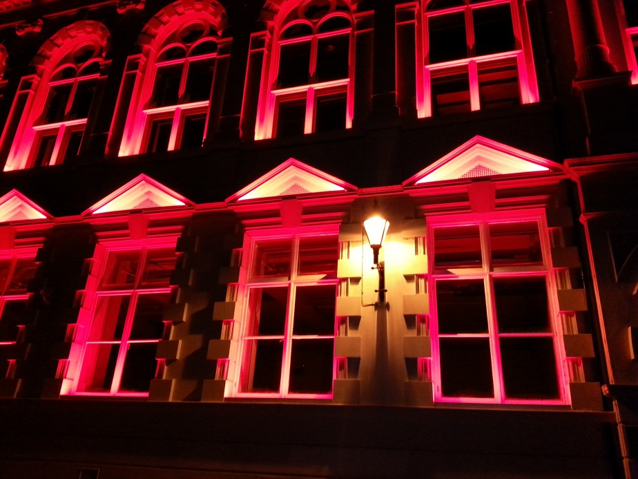
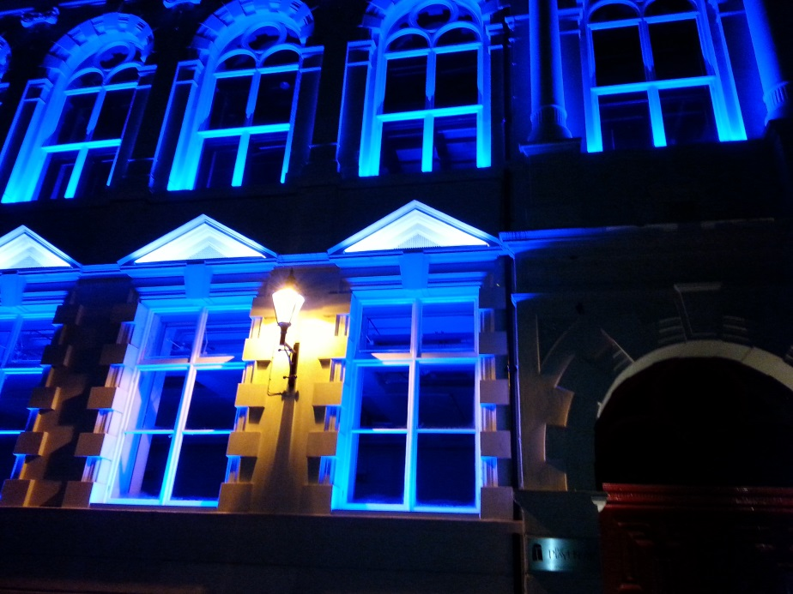
Culture and Tourism

Slide 18
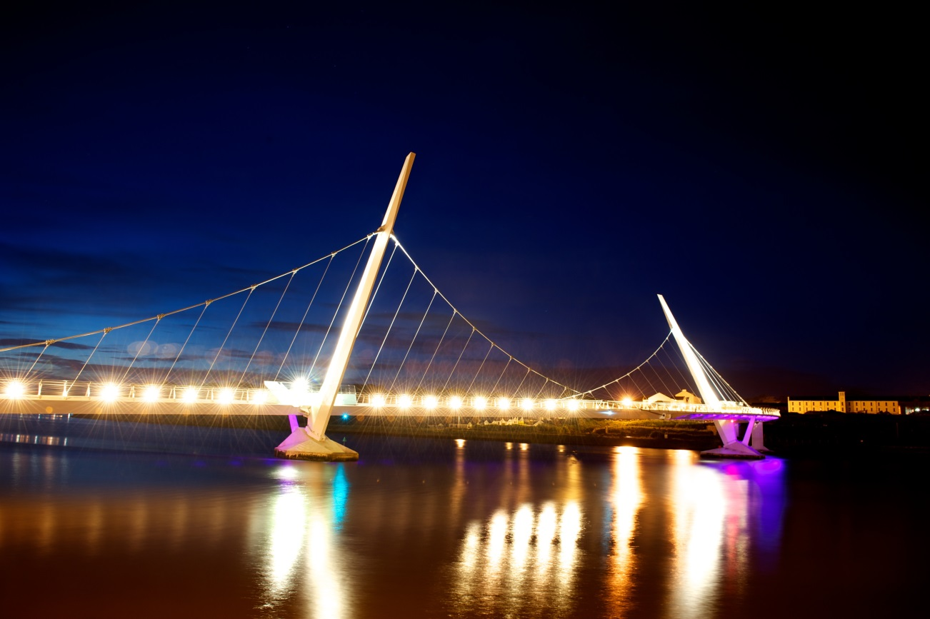

Culture and Tourism

Slide 19
Trips around Londonderry

Slide 20
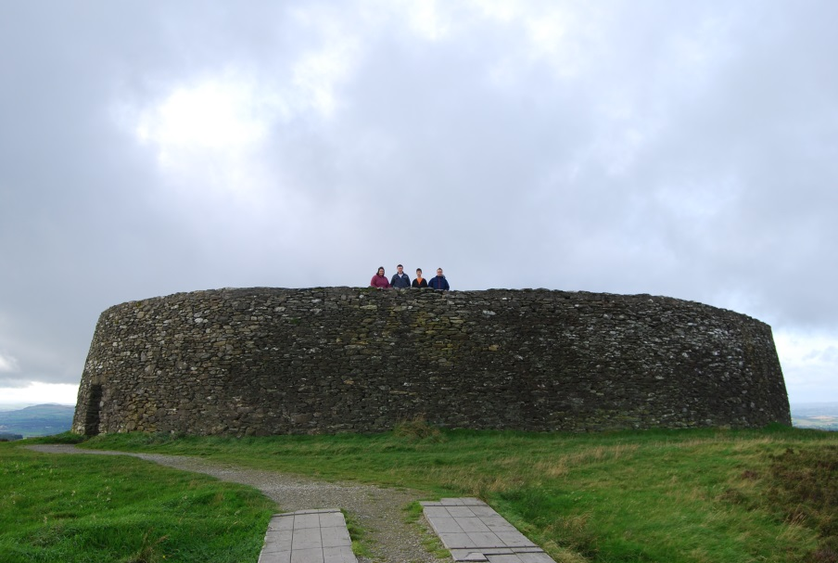
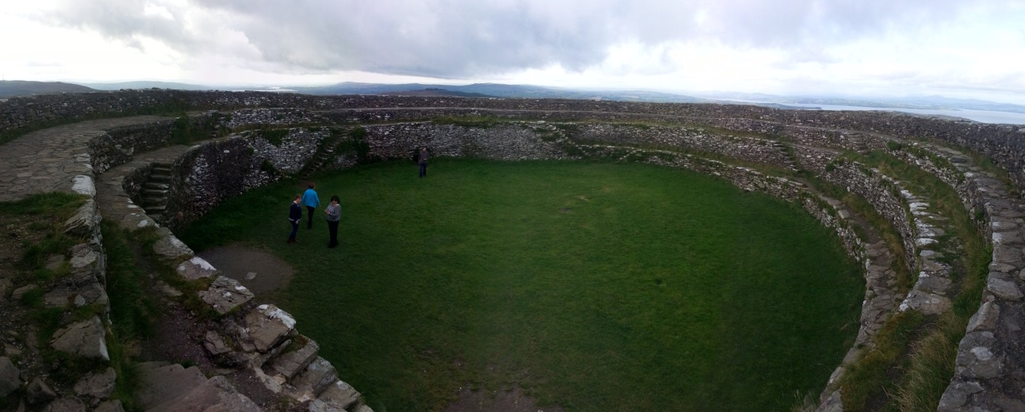
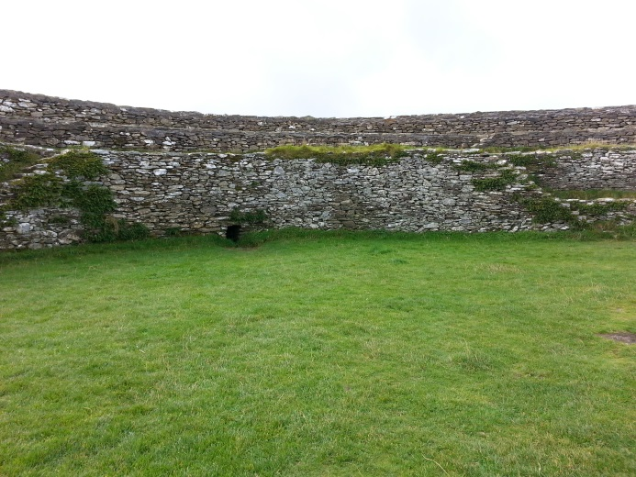
Forts - Grianan of Aileach

Slide 21
Forts - Grianán of Aileach
The fort was built of stone in the 6th century or earlier, on a hill and has sight over a large distance.
It was the fort of the great kings, who ruled over the people around the hill.
Defending against attackers was easy. They threw stones from the walls and hid in gaps in the walls behind grids.
The fort was destroyed and restored in 1870.
The fort is near the border between Ireland and Northern Ireland.

Slide 22
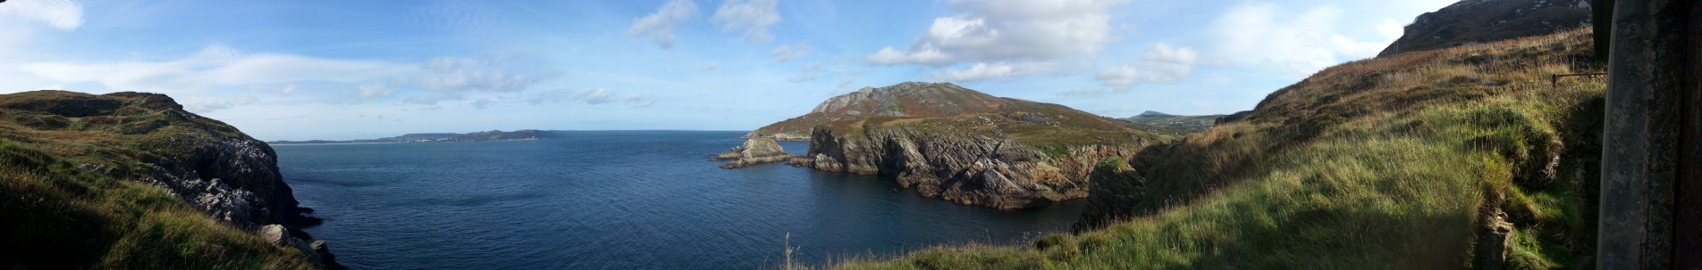
Forts - The military forts
There are 7 forts around the coast in the Republic of Ireland.
On each side of the coast there are 3 forts, which are parallel and one is on an island.

Slide 23
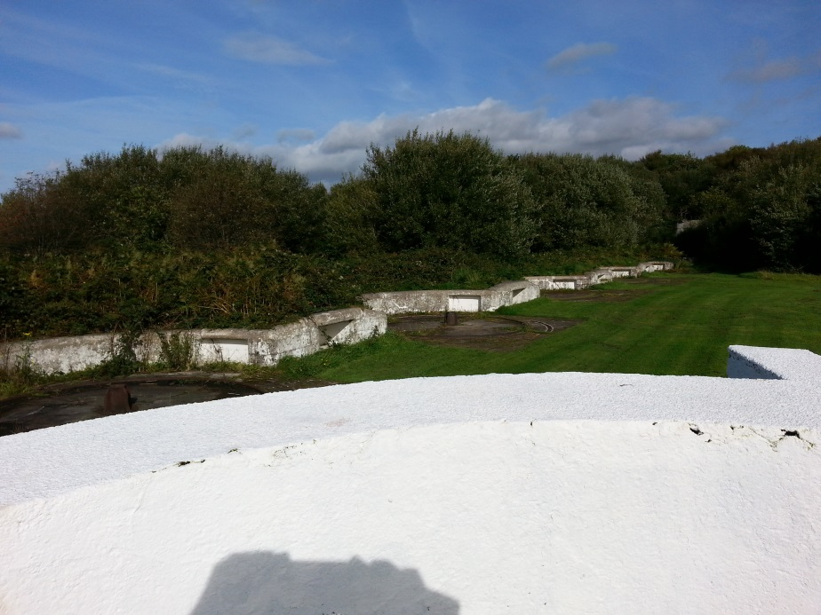
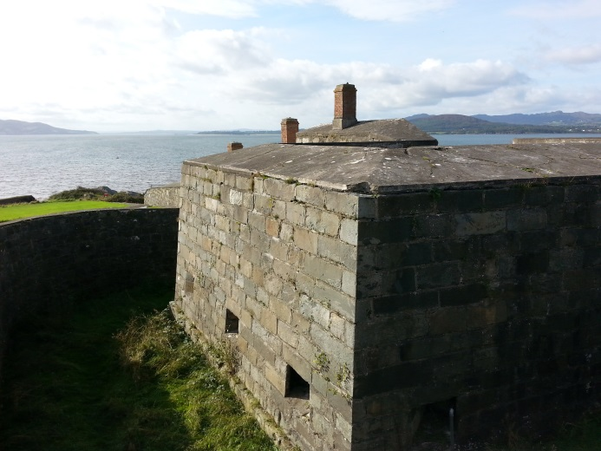
Forts - The military forts
The military fort in Buncrana has no cannons and you can‘t enter it.

Slide 24
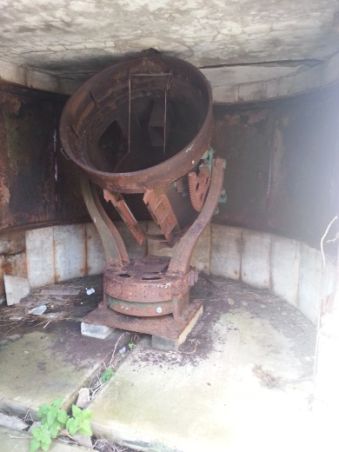
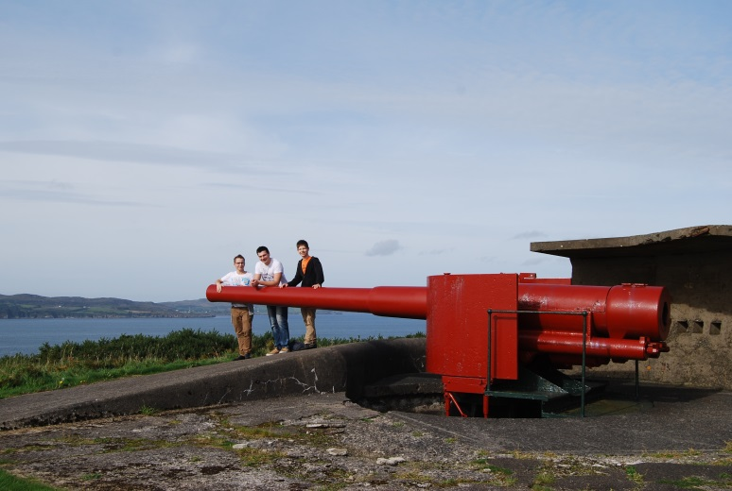
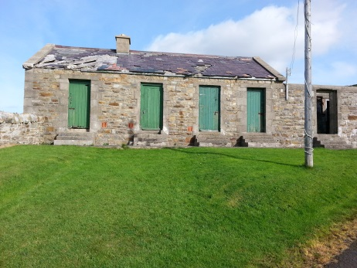
Forts - The military forts
The Military Base in Dunree is a Museum and still in use for military training
There are some cannons, bunkers and buildings left, so you can see how the soldiers lived

Slide 25
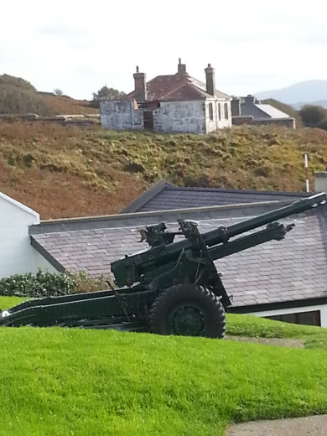
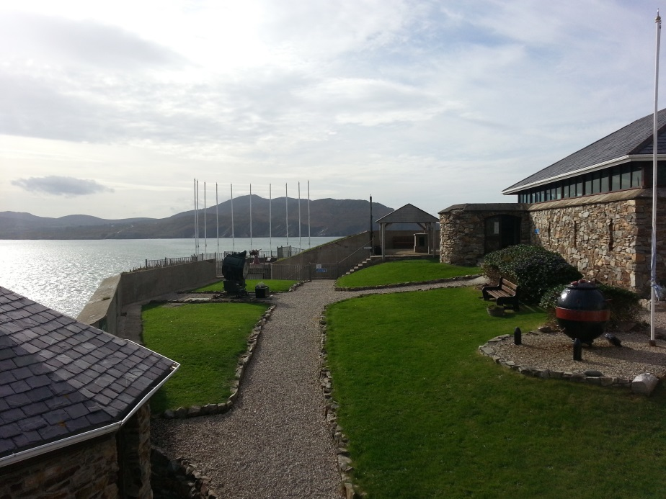
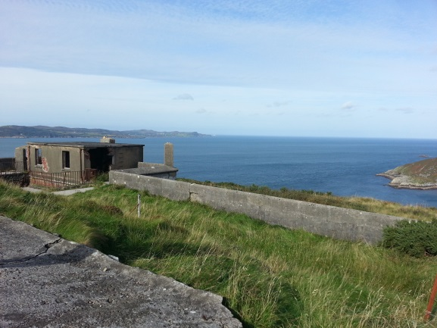
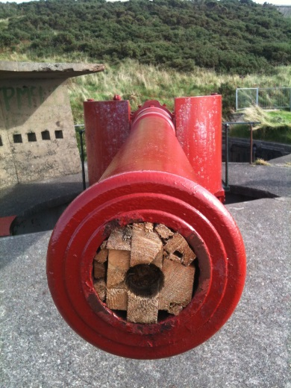
Forts - The military forts

Slide 26
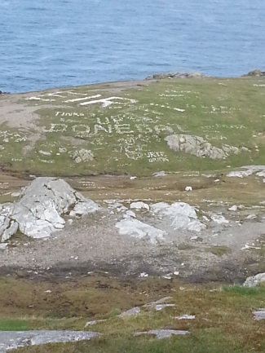
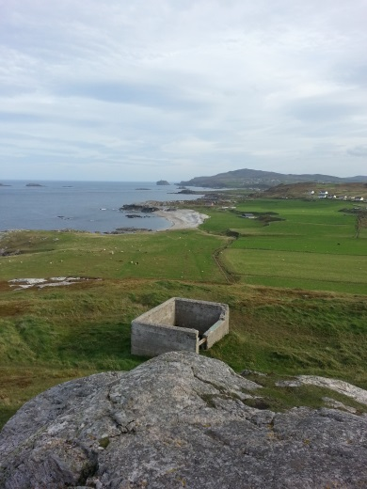
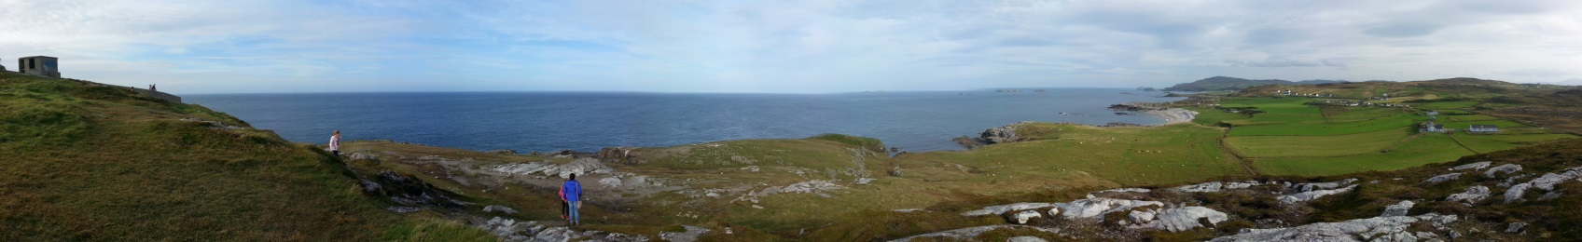
Most northern point of Ireland
In good weather conditions you can see Scotland and animals like Dolphins.
The coast is a very good diving area.

Slide 27
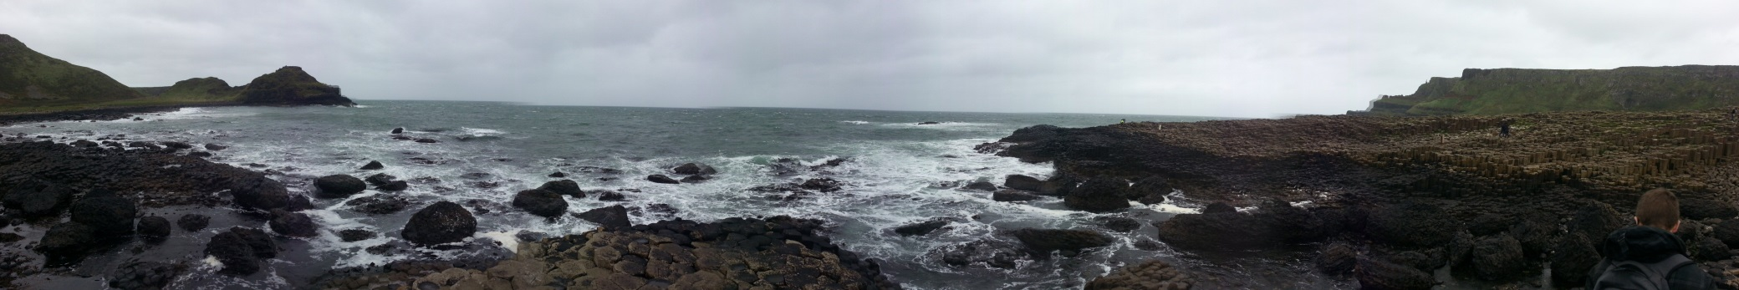
Giant‘s Causeway
Legend:
The giant Finn challenged the Scottish giant Benandonner, to reach Scottland. Finn built the causeway out of a mountain.
Benandonner was bigger than Finn, so he ran away and Finn's wife hid him.
When Benandonner found Finn, his wife said it was her child and he thought Finn had to be really big.
Benandonner destroyed the causeway when he ran back to Scottland.
Reality:
The causeway is a result of a volcanic eruption.

Slide 28
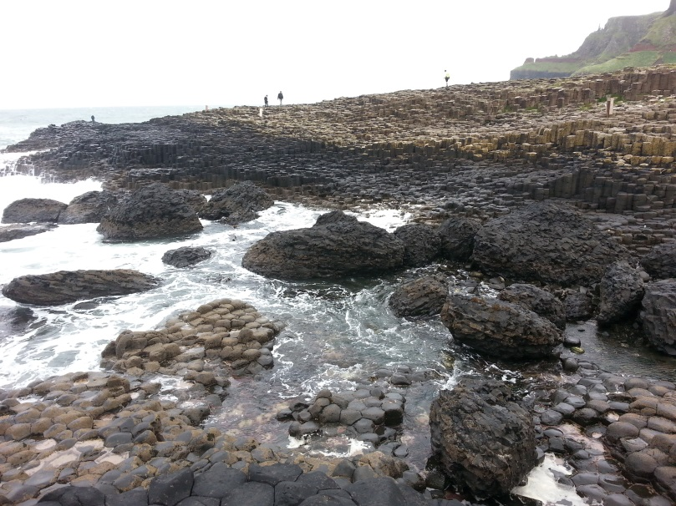
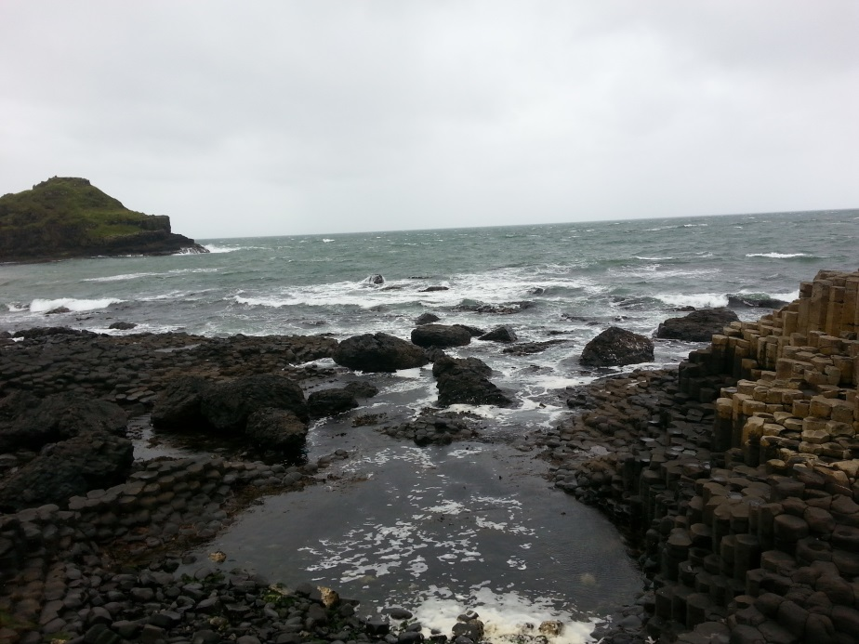
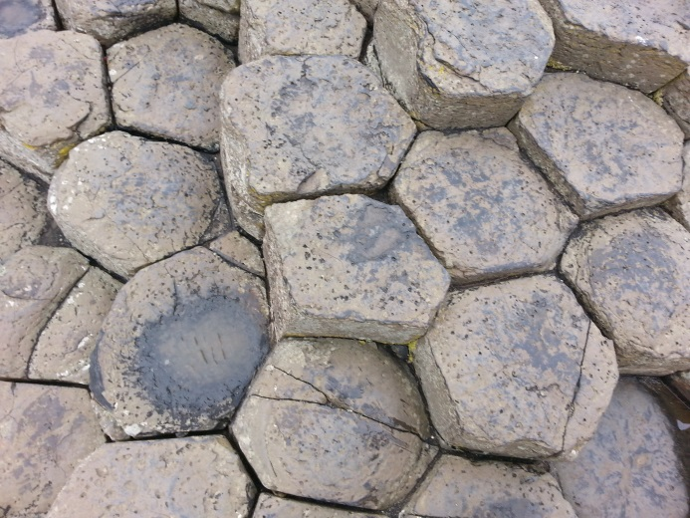
Giant‘s Causeway

Slide 29
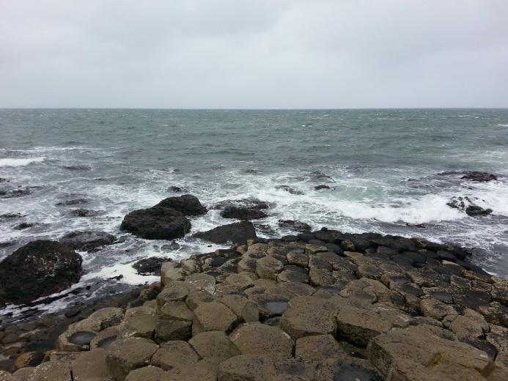
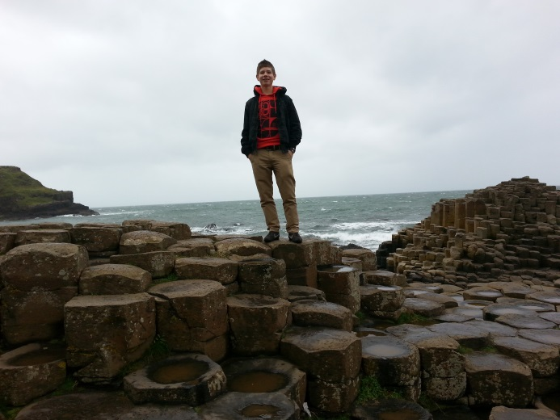
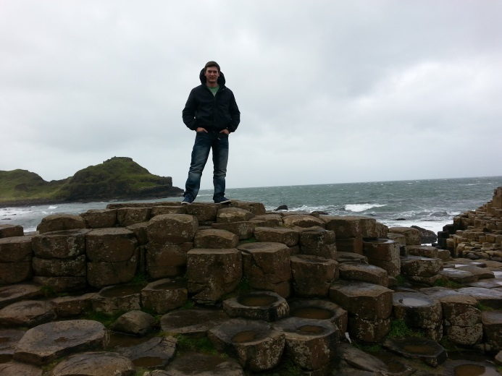
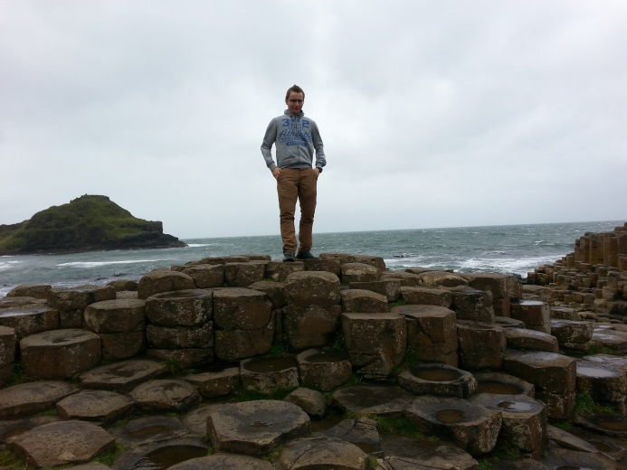
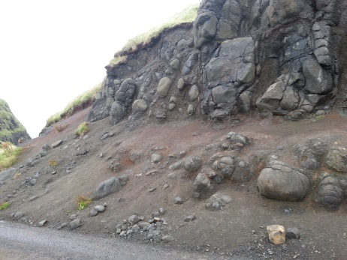
Giant‘s Causeway

Slide 30
Sporting Activities

Slide 31
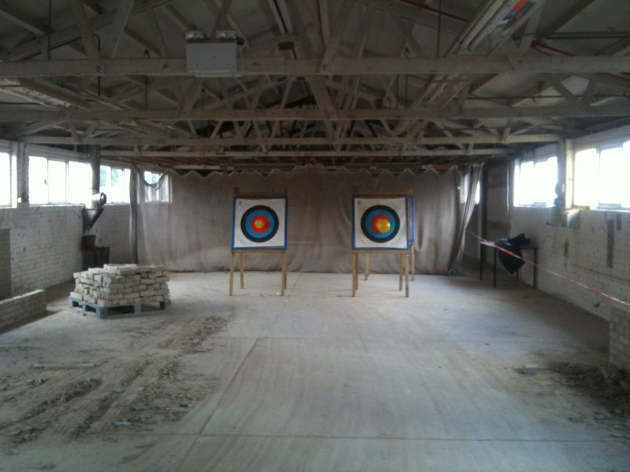
Archery
What did we d0?
Together with two trainers
we shot with sport
bows and arrows.
Where did we do it?
In a old factory hall of the
North West Regional College.

Slide 32
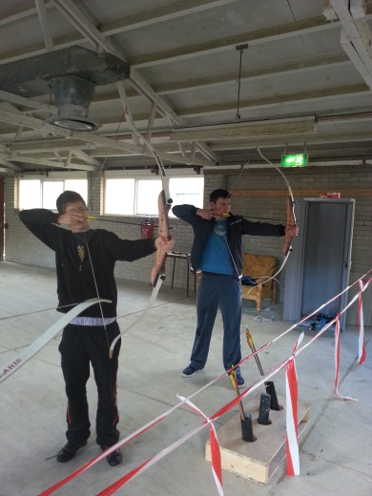
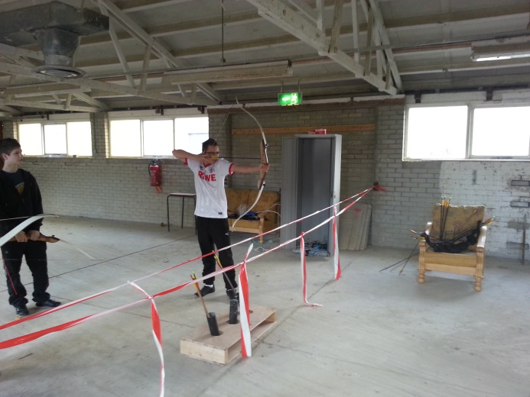
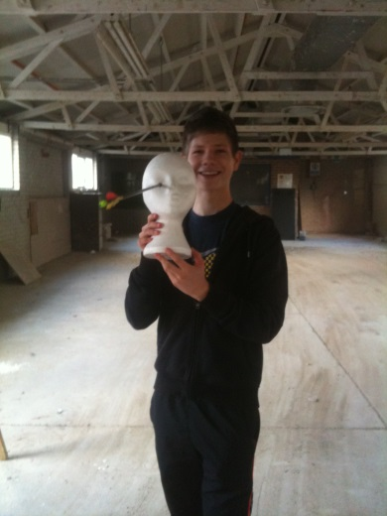
Archery
You see us three in action with the bows and arrows.

Slide 33
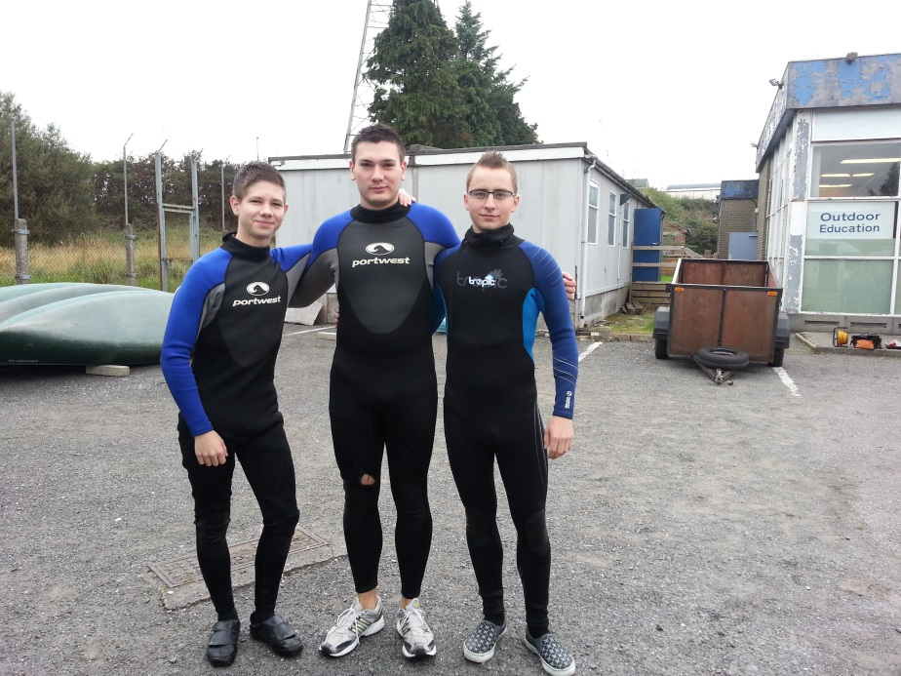
Canoeing
What did we do?
We canoed together with
2 students and two trainers
of the North West Regional
College.
Where did we do it?
We did the canoeing on a
little lake near the city.
Notes:
After we had finished Canoeing, we take this picture

Slide 34
Other sporting activities
We swam in a sport center.
We played football in a big hall next to the sport center.
We walked on the cliffs and jumped from them in wet suits.

Slide 35
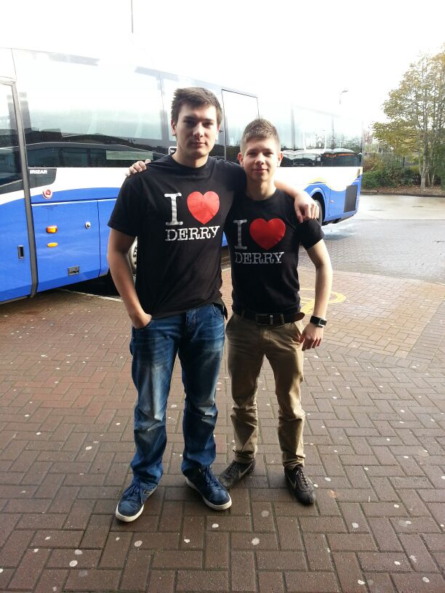
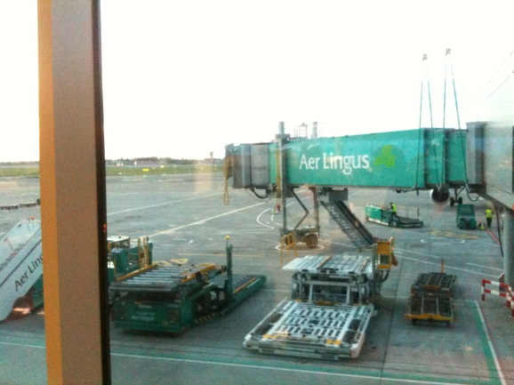
Journey home
1th of November, 2013
Journey start: 10am
By car, plane and bus
Arrival: 10pm

Slide 36
Impressions and experiences
We learned much about the conflict in Northern Ireland between Catholics and Protestants.
The Irish people are very kind, helpful and humorous.
We also got some impression of the Irish culture.
We improved our English, got more confident and experienced to live in a group.

Slide 37
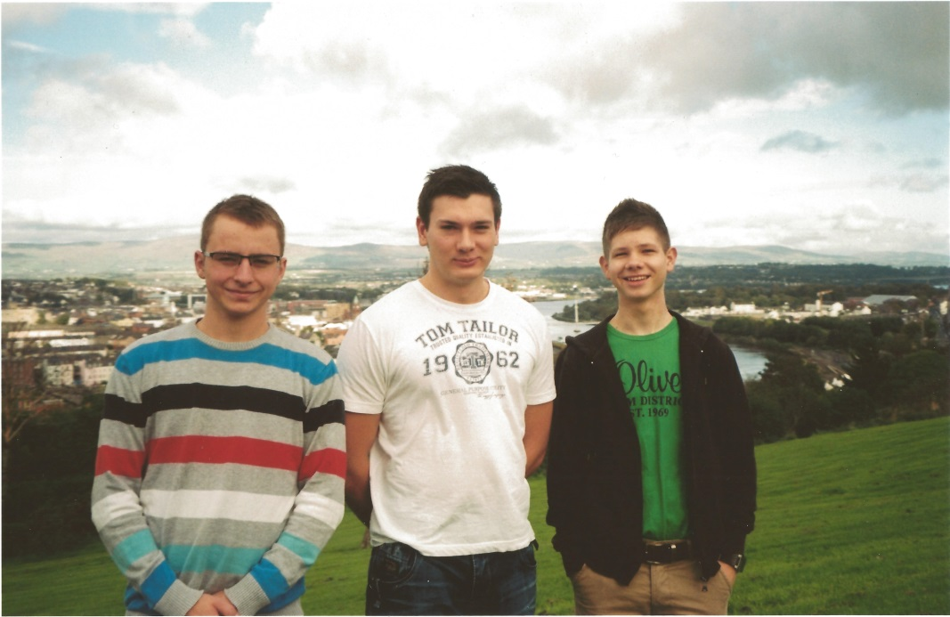
The end
Thank you …
… for your
attention

