Slide 1
Traineeship in Northern Ireland
Belfast & Derry

Slide 2
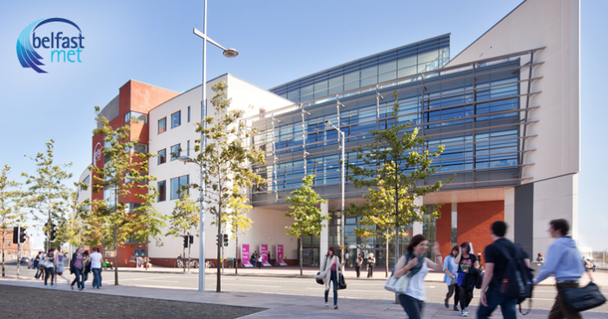
work at the BelfastMet
We tested the performance of applications on different systems and inserted the results into an Access-Database.
After the testing we analized the stored procedures of the intranet- and the internet-website. Then we created a documentation about stored procedures for the internet- and intranet-website
In the last week we tested all Adobe-, AutoDesk- and Developmentkit-Software on one workstation and two normal PCs.
Joshua Hahn
Florian Martens
Fabian Wloch

Slide 3
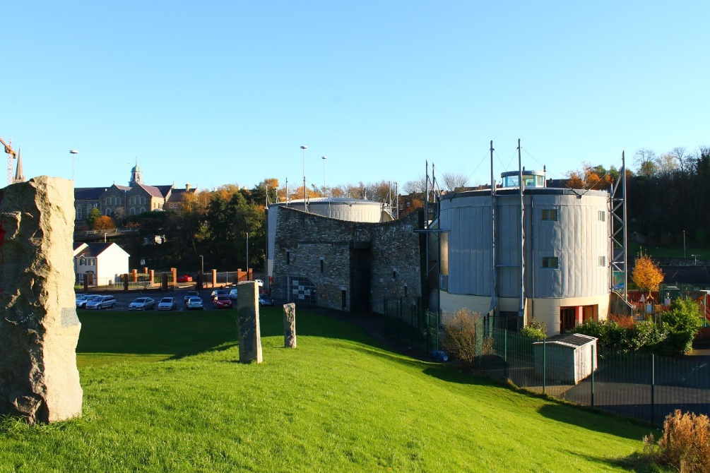
work at the Gasyard Centre
We improved the websites of DerryBlueBadgeGuide and the Namagha Camogie Club
We worked with CSS, Php, JavaScript, HTML and Wordpress
Patrik Albus
Patrick Muks

Slide 4
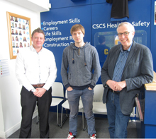
work at the Craft Recruitment
I worked on a PHP-Application which was connected to a MySQL-Database. The purpose of this PHP-Page, is for inserting information about trainees and save them in a table.
I worked with CSS, PHP, HTML and MySQL
Thomas Esau

Slide 5
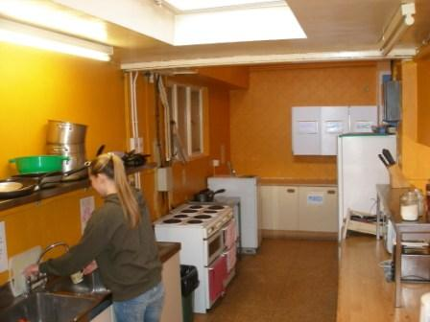
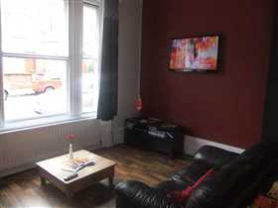
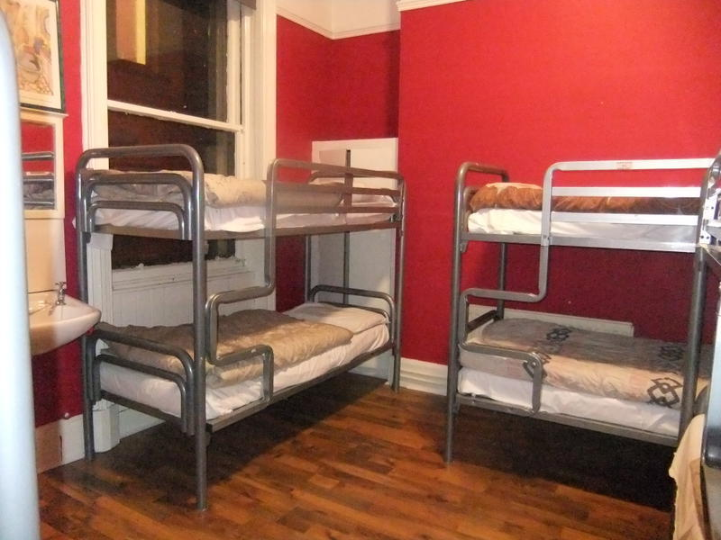
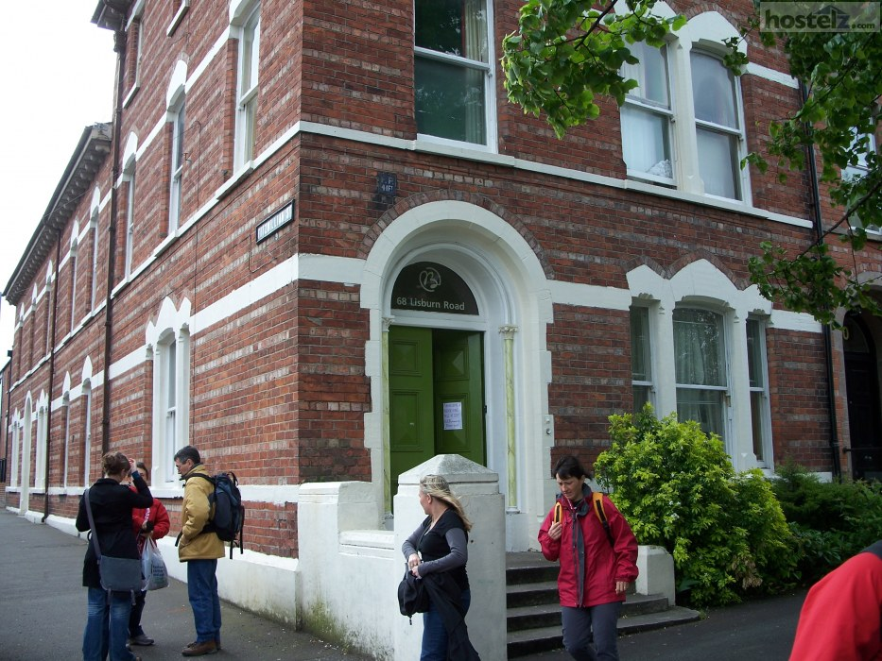
accommodation Belfast
Paddy's Palace Belfast
nice staff
small hostel near the city centre

Slide 6
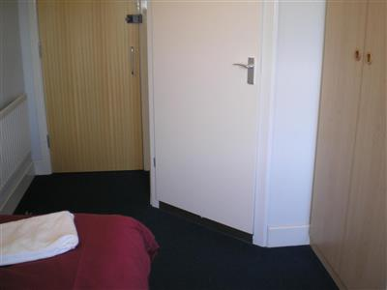
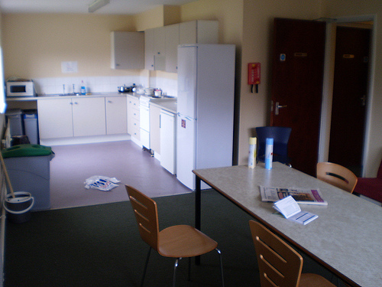
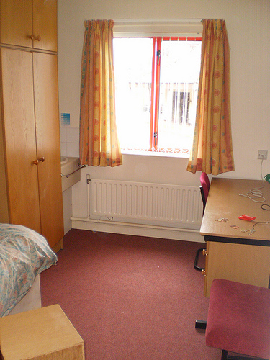
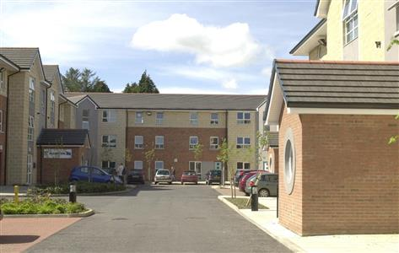
accommodation Derry
Duncreggan student village
every student with his own little room
shared toilets, showers and an own kitchen

Slide 7

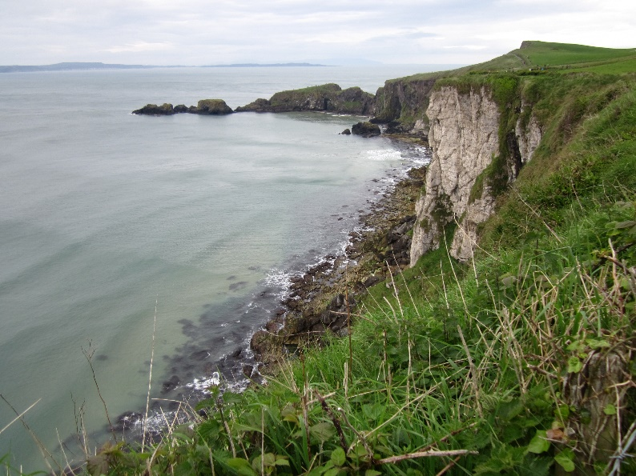
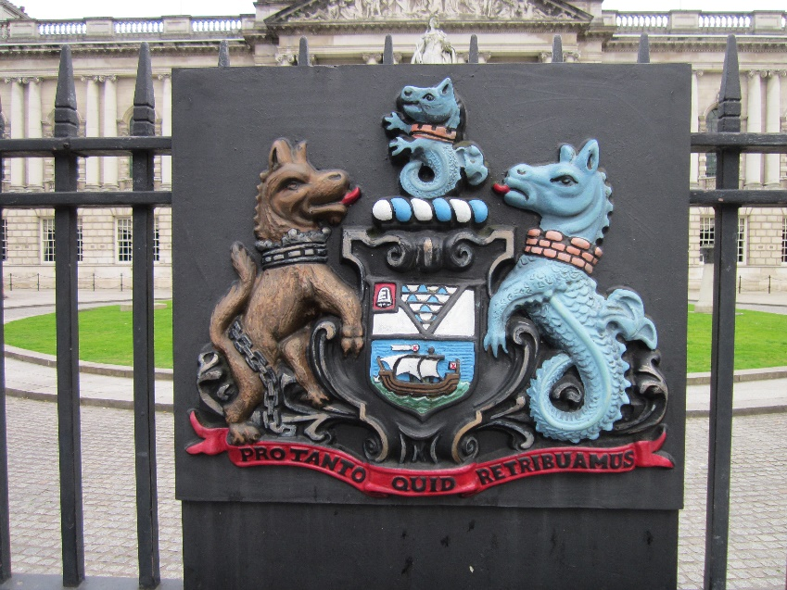
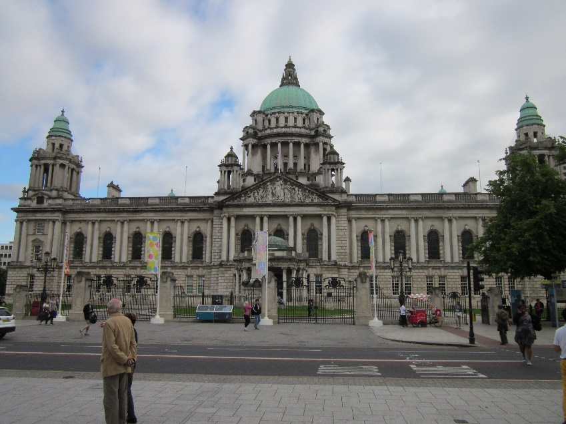
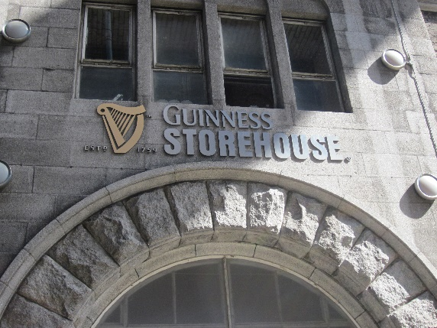
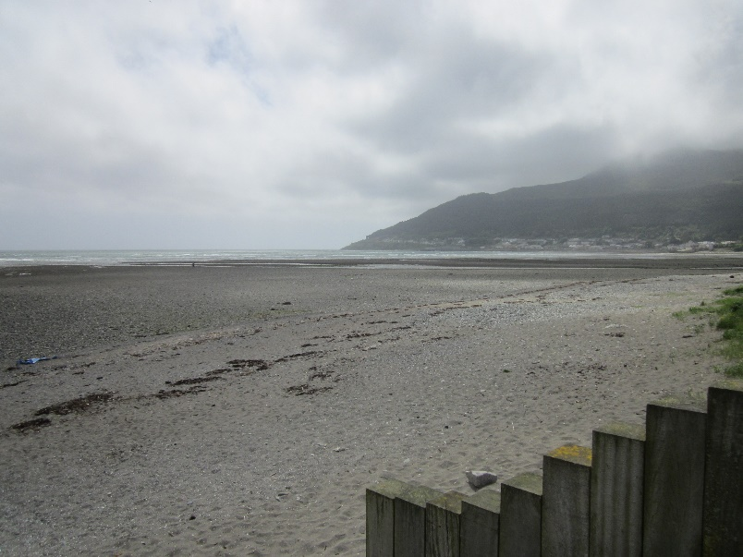
leisure time
- In our free time we did some tours.
- For example we visited the Giants Causeway, Donegal, the Bushmills Distillery, the Belfast Zoo, Cave Hills, New Castle and at the last weekend Dublin
- Or… we went to a few pubs, played pool or watched some movies in the cinemas

Slide 8
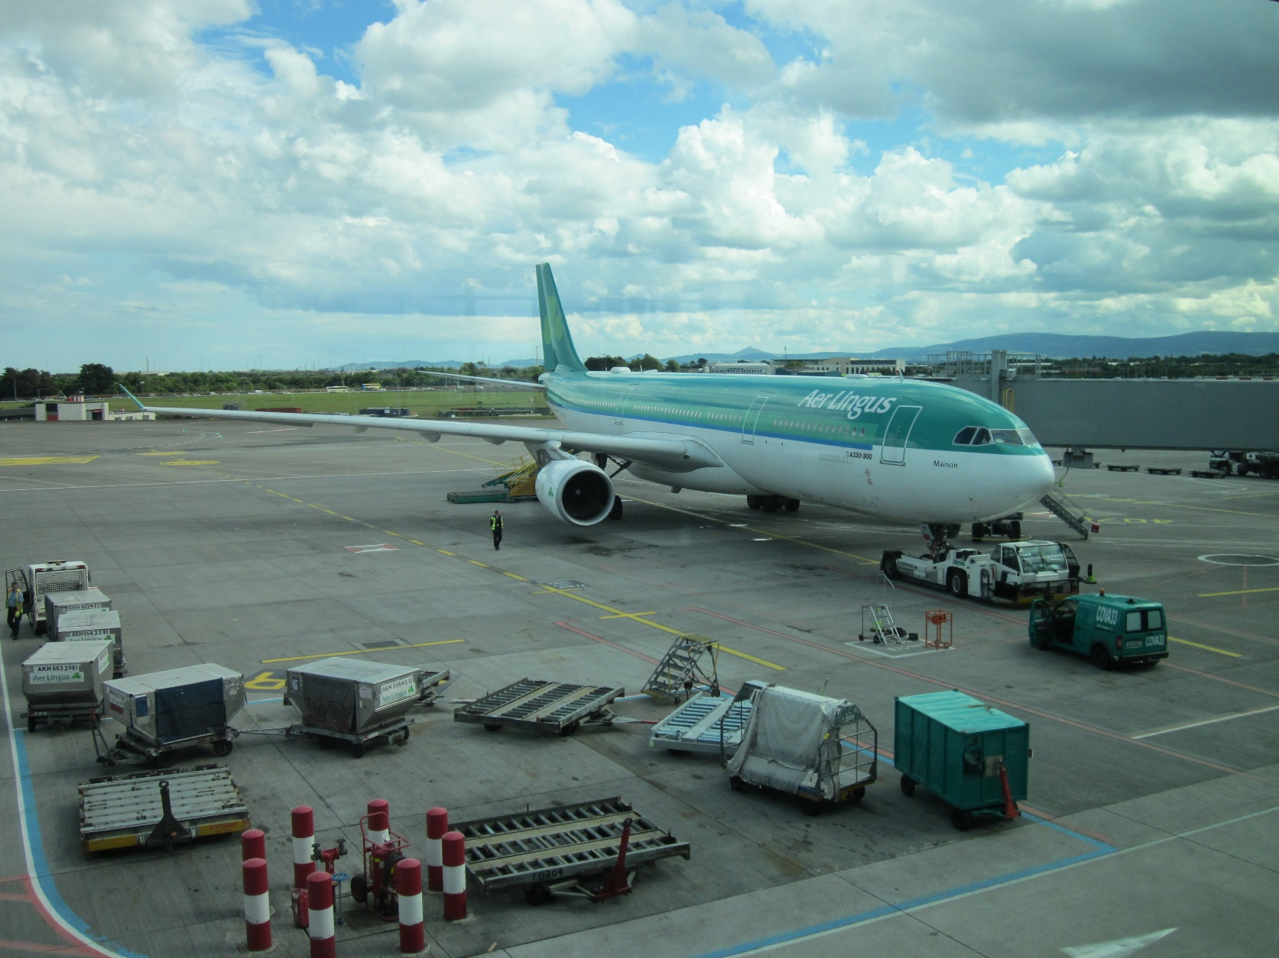
thank you for the attention
Many thanks to the colleagues of the
north west regional college
in Derry
and the
Belfast Metropolitan College
in Belfast
who put a lot of work into
this project and
made this great experience
for us possible!
and special thanks to
Mr. Köster for his commitment
and organization!

