Slide 1
Work Experience in Northern Ireland
by Jan, Florian and Sergej

Slide 2
Contents:
Reasons for going to Northern Ireland
Arrival in Derry/Londonderry
Accommodation
The city of Derry/Londonderry
Presentationof the NWRC / individual departments
Trip to Dublin

Slide 3
1. Individual reasons for the trip
Improvement of the English language
Experience in a foreign country in an unknown environment
Improvement of our hardskills in computer science
Improvement of our chances in the future
Getting the feeling how it feels to live without parents

Slide 4
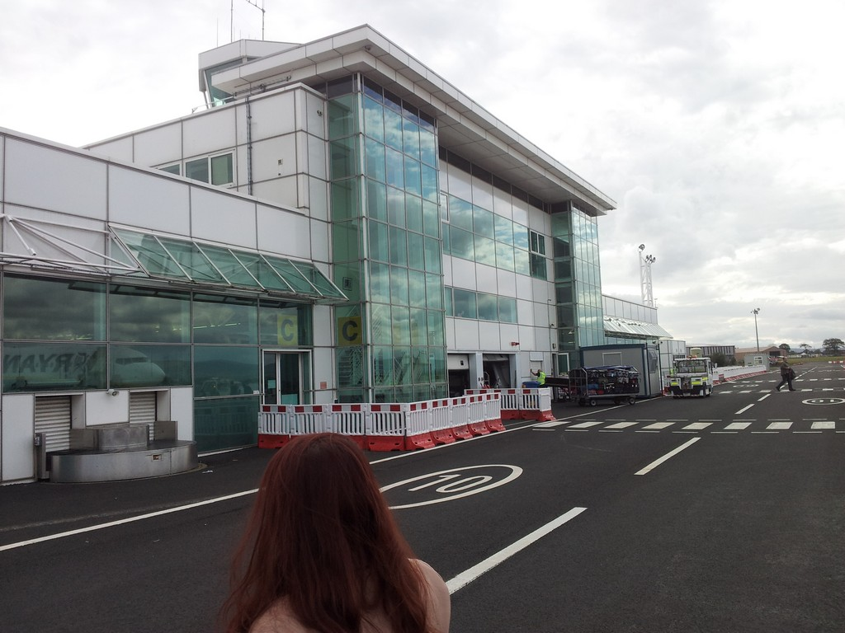
2. Arrival in Derry

Slide 5
Arrival in Derry
The arrival in Derry was very comfortable. Willie collected us from the airport and brought us to our apartement, which you can see on the next page.

Slide 6
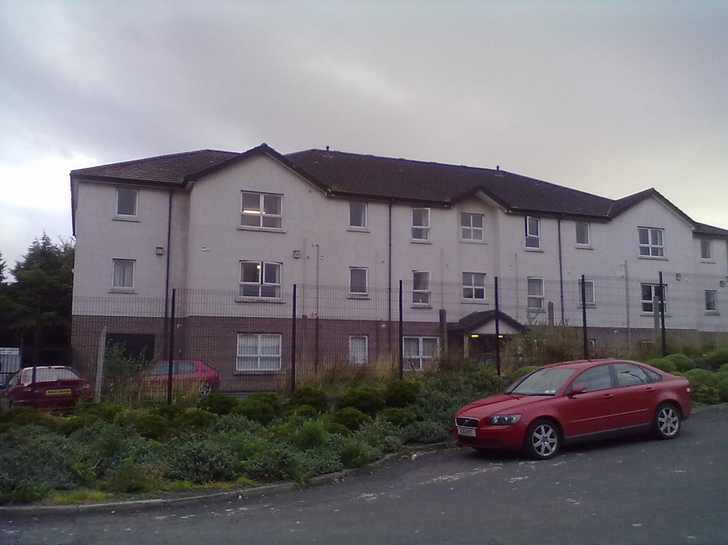

Slide 7
3. Our Apartement
The apartement was a good place for us. It was about a five minutes walk away from the college and 15 minutes from the city centre. We had a gym close to our apartement. So we got a membership for two months in the gym
Inside the apartement it looked like you can see in the next picture (It was Florians room.)

Slide 8
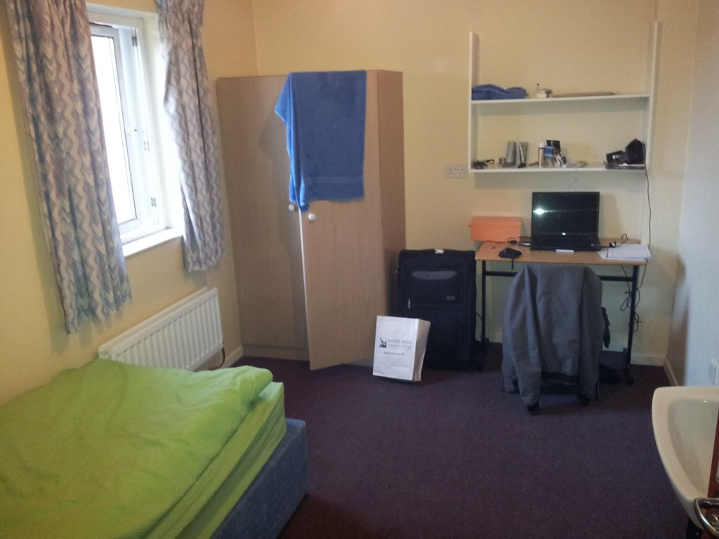

Slide 9
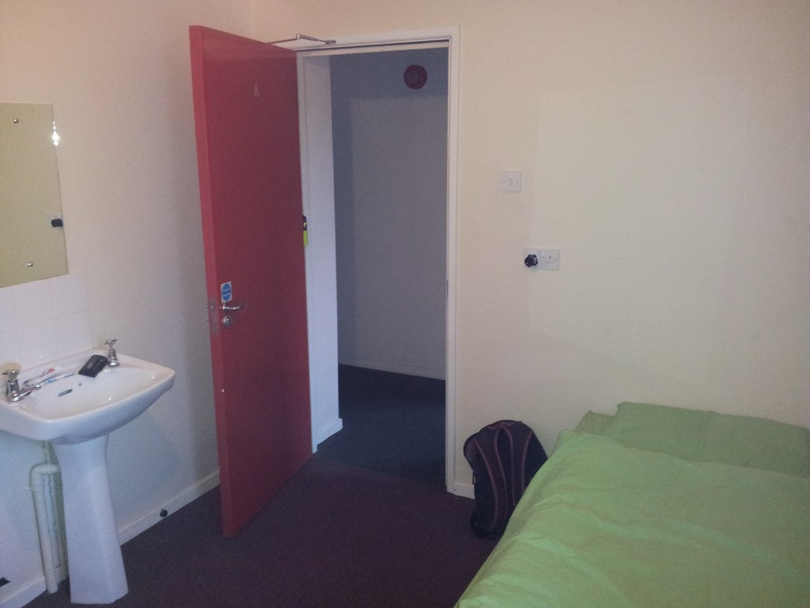

Slide 10
4. Food and Accomodation
Normally we had to cook for ourselves. It was a good experience for us. But sometimes Willie brought us a great meal, which his wife had cooked for us
We had to keep our own household. We had to plan what we needed, go to the supermarket and keep the accommodation clean.
Additionally we had to cooperate, dealing with eventual psychological problems, like for example homesickness.

Slide 11
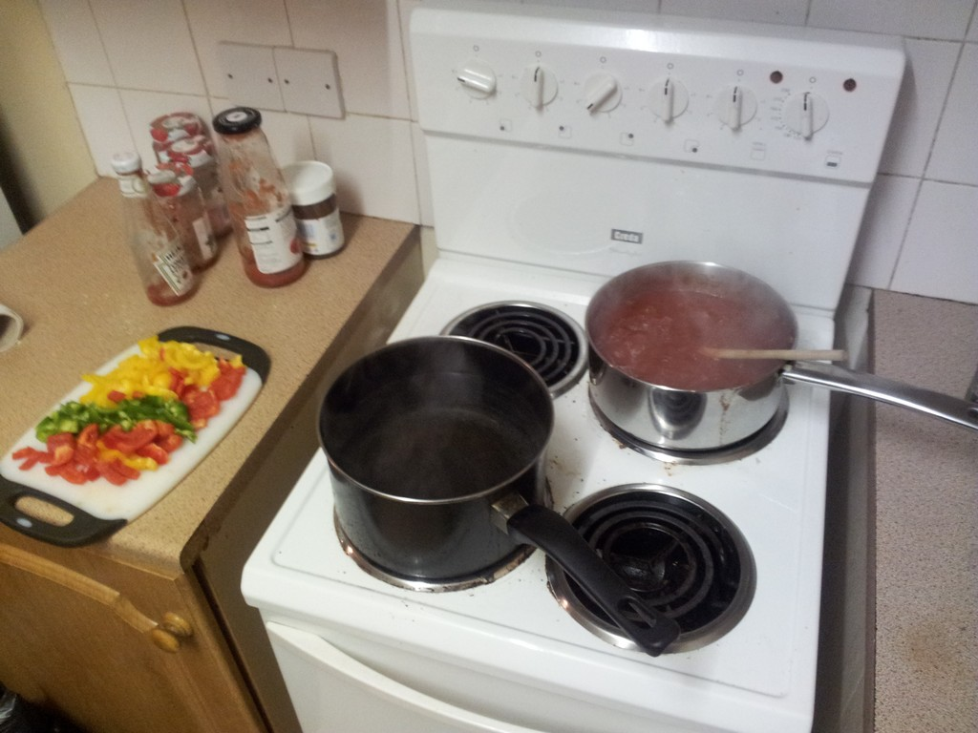

Slide 12
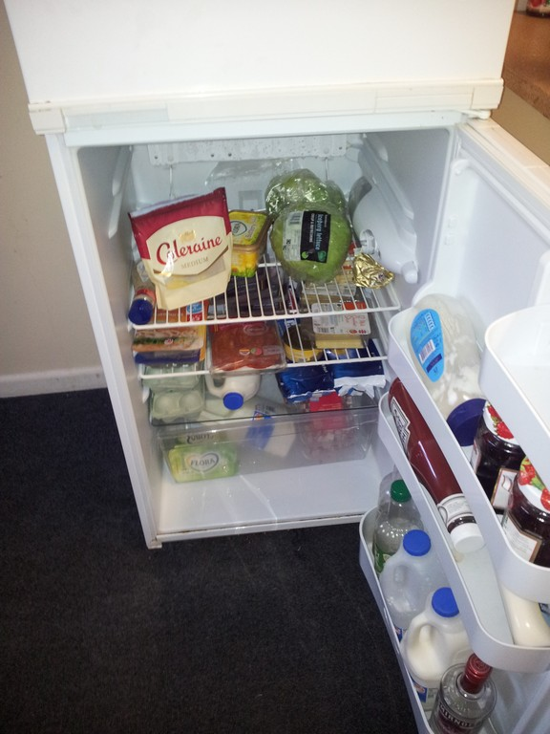

Slide 13
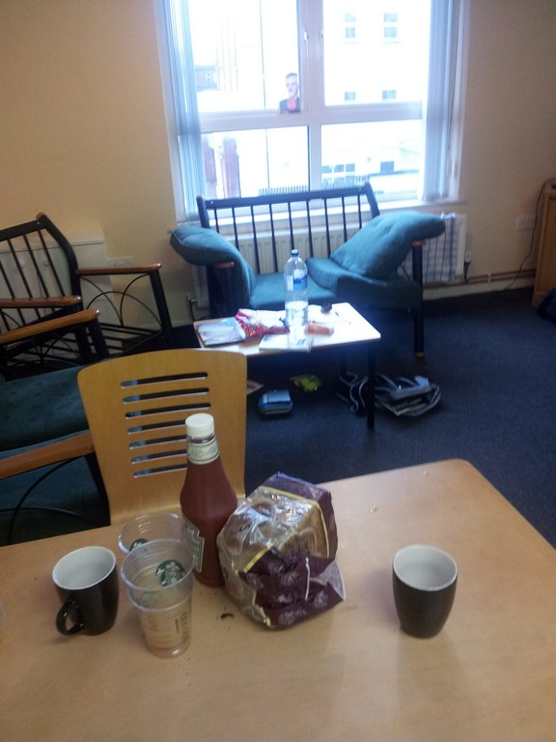

Slide 14
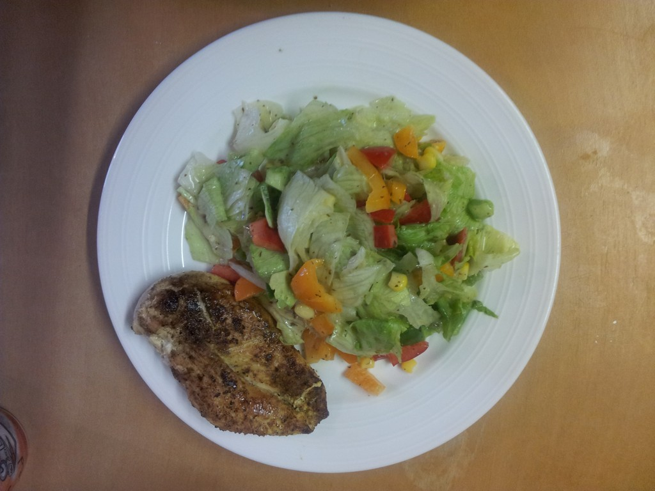

Slide 15
6. The City of Derry/Londonderry
Derry/Londonderry is a beautiful city with many beautiful sights .
It was a honour for us to visit this beautiful city and also the interesting museum about Derry/Londonderry
Derry/Londonderry has an interesting history which we learned about in the museum.
Enjoy some of the the sights of this beautiful city by
watching the following pictures.

Slide 16
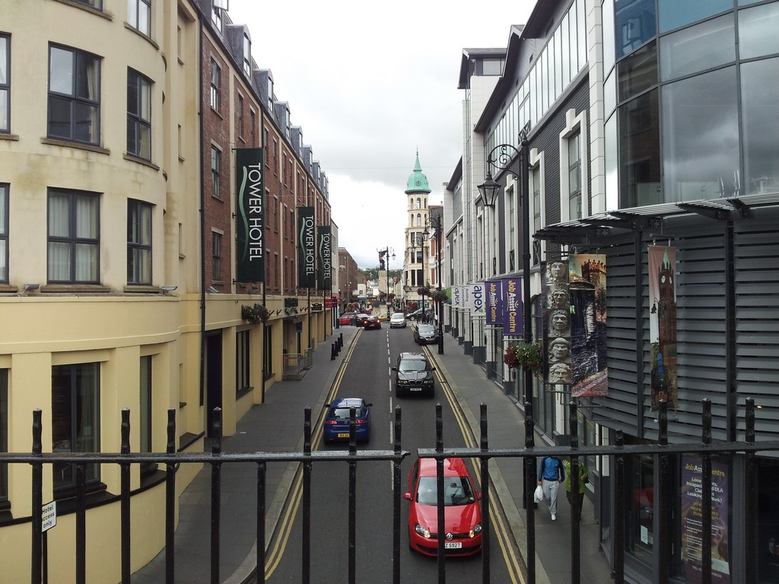

Slide 17
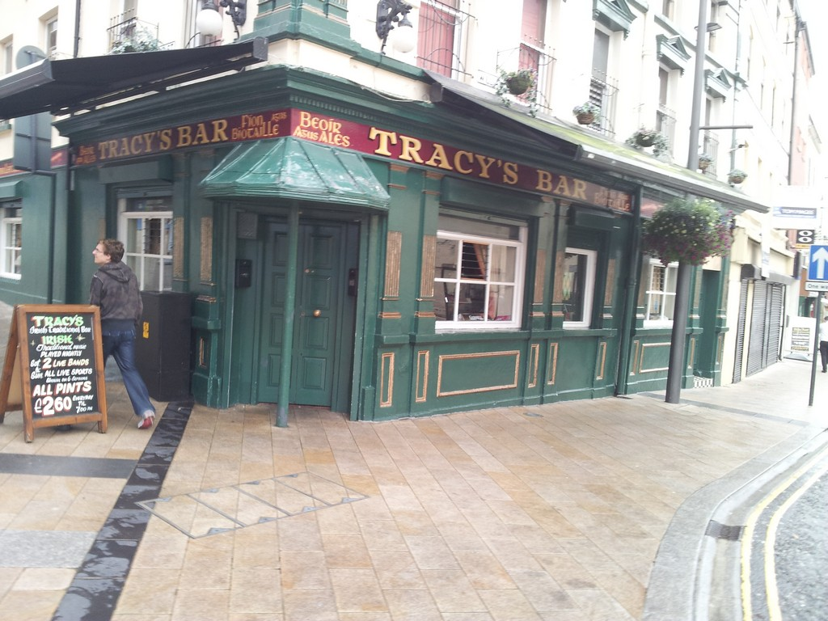

Slide 18
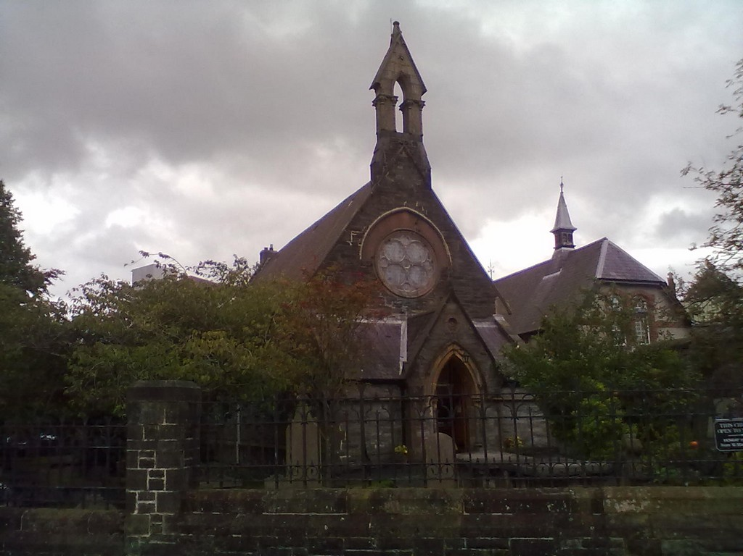

Slide 19
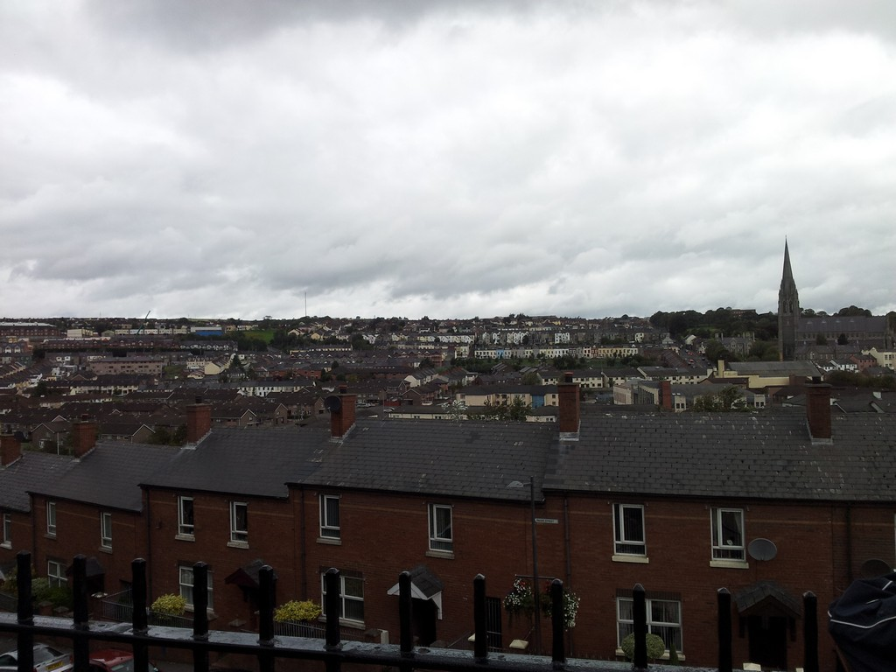

Slide 20
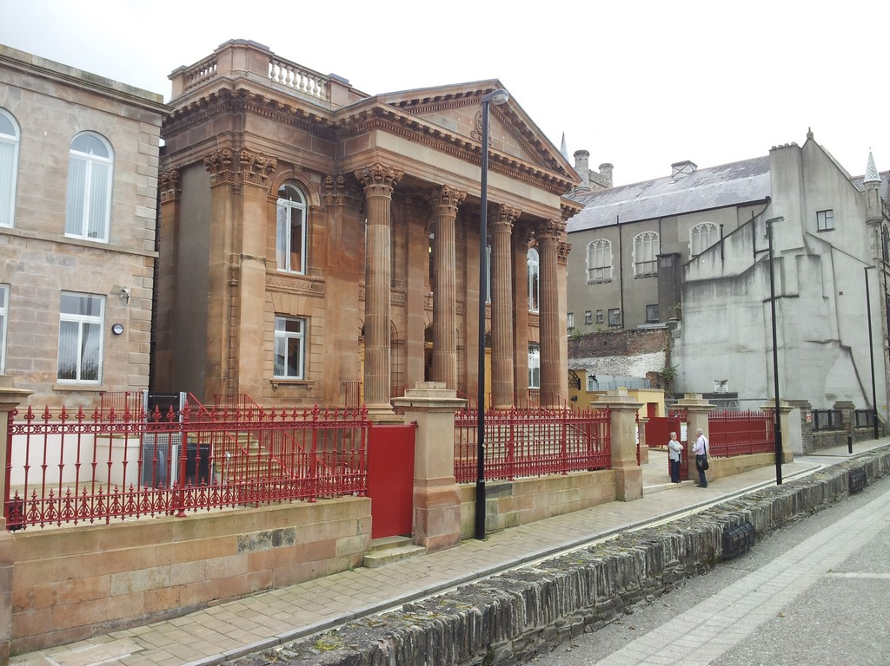

Slide 21
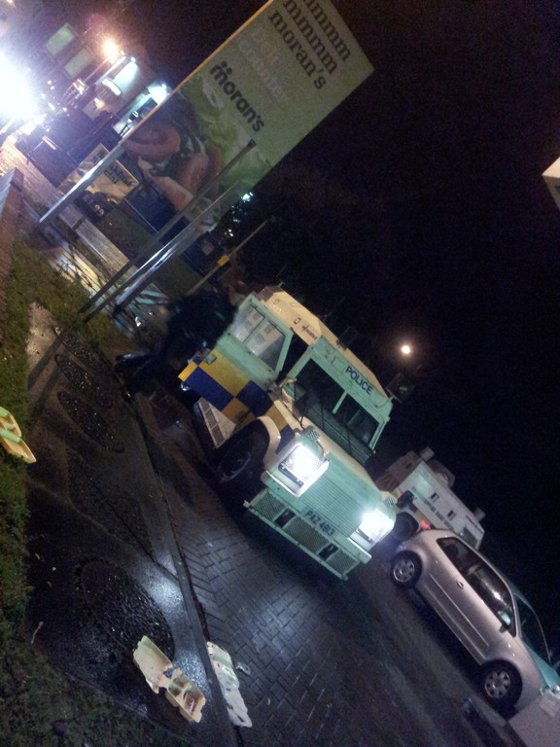

Slide 22
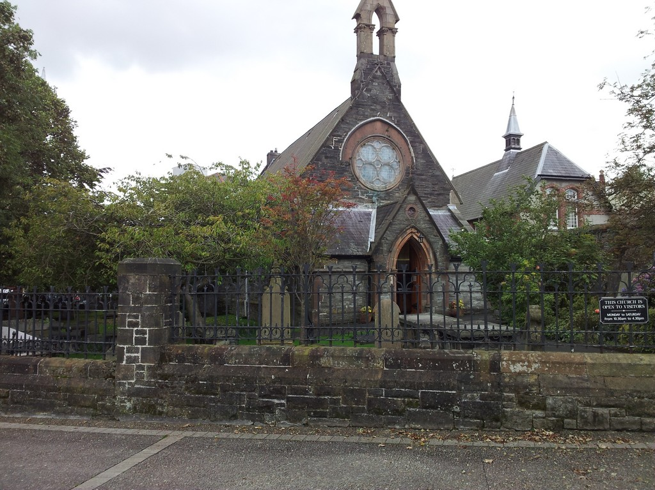

Slide 23
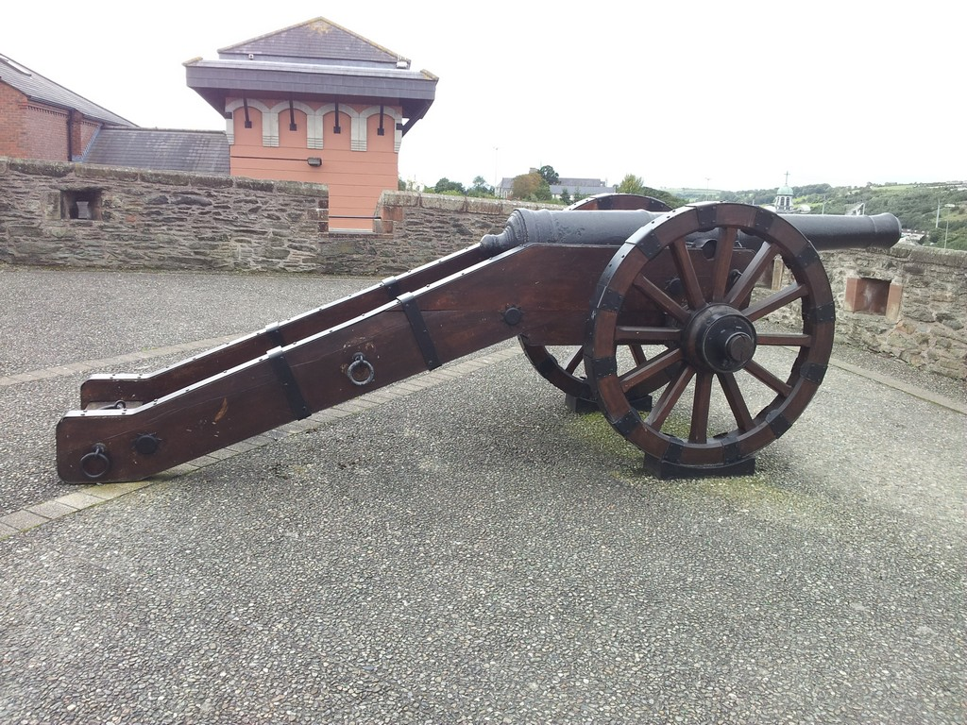

Slide 24
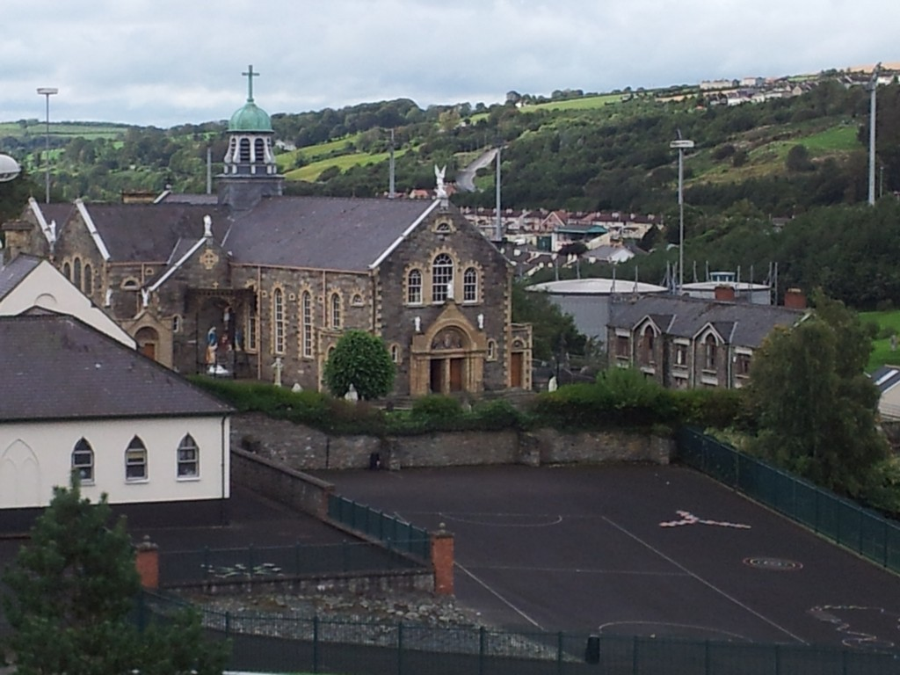

Slide 25
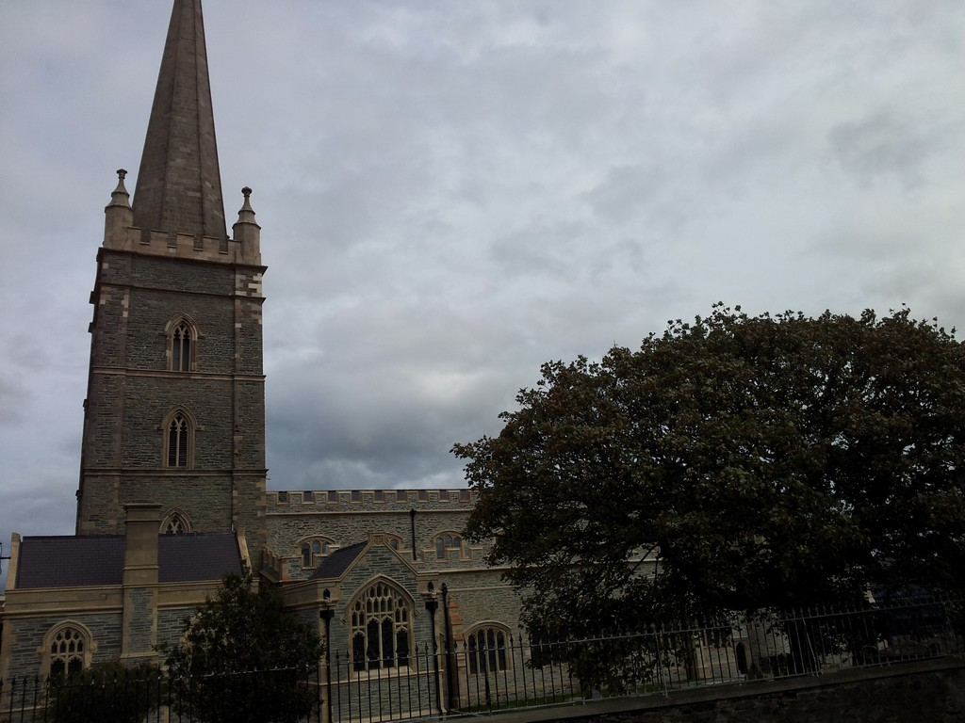

Slide 26
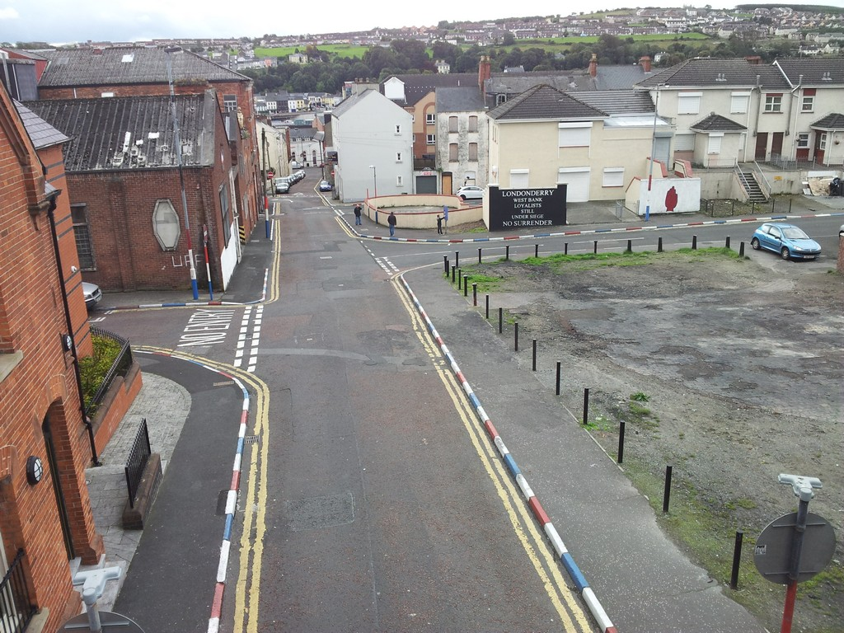

Slide 27
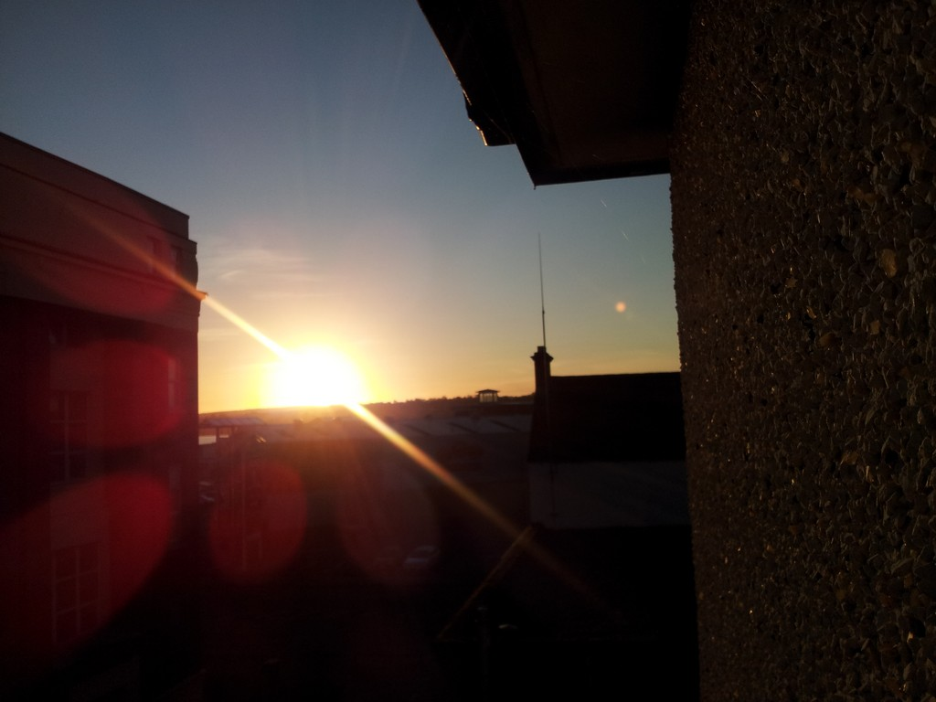

Slide 28
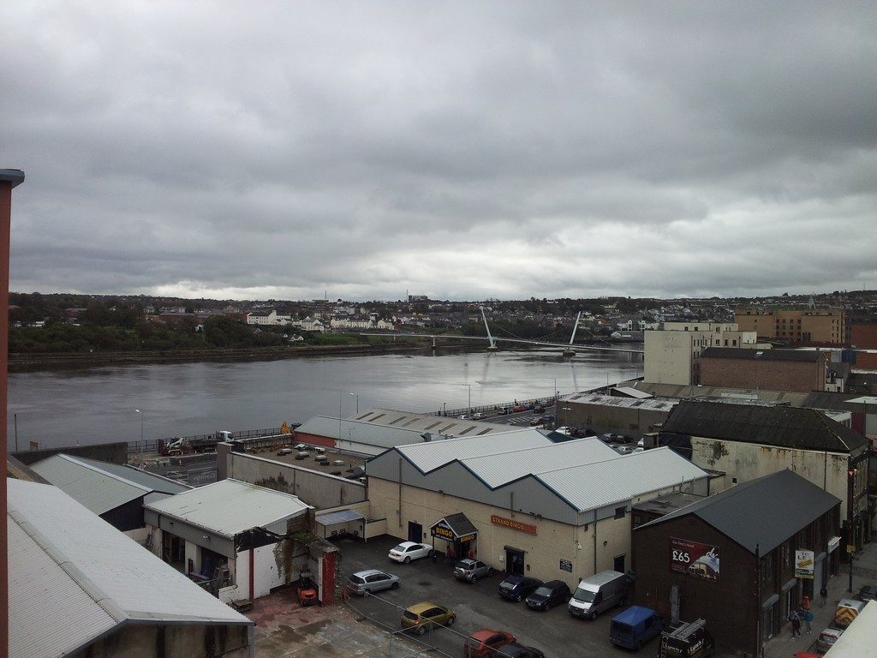

Slide 29
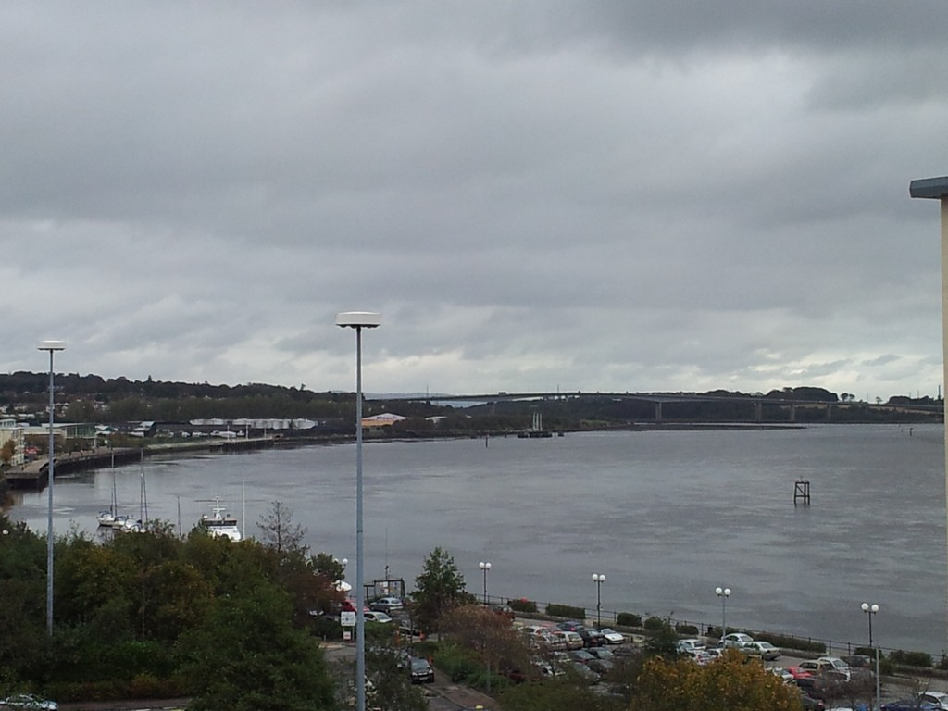

Slide 30
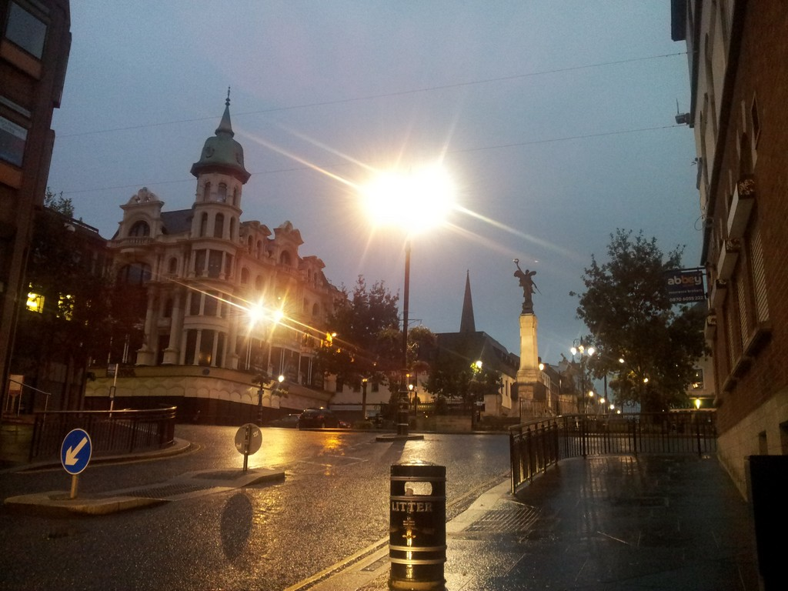

Slide 31
5. Nature around Derry/Londonderry
Not only the city is beautiful but also the nature around Derry/Londonderry. You can form your own opinion by watching the next pictures.

Slide 32
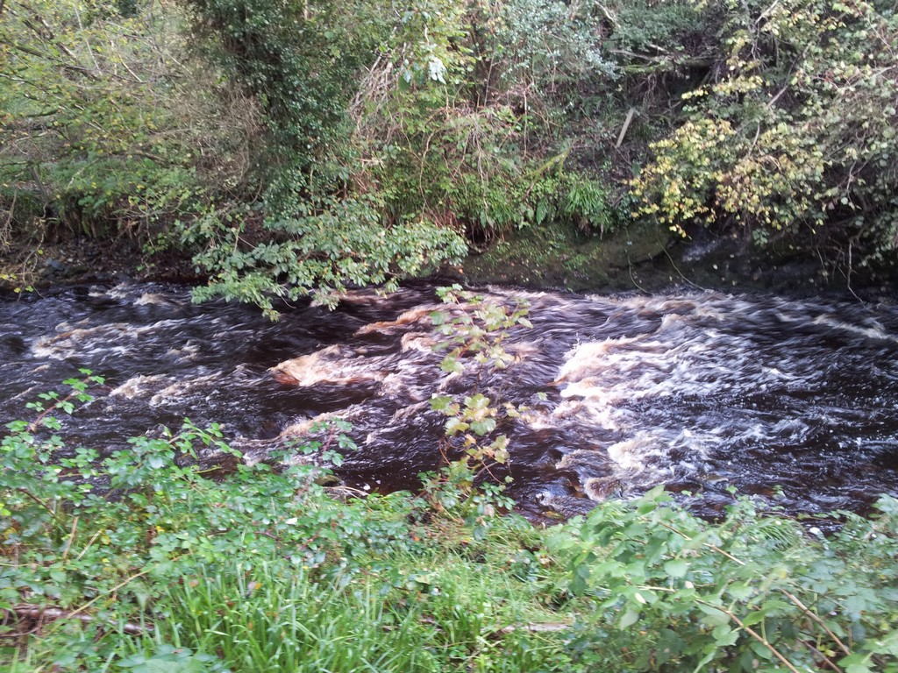

Slide 33
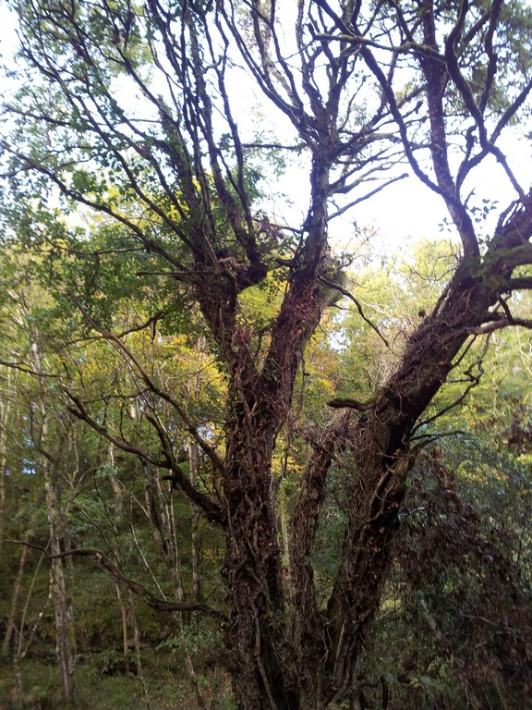

Slide 34
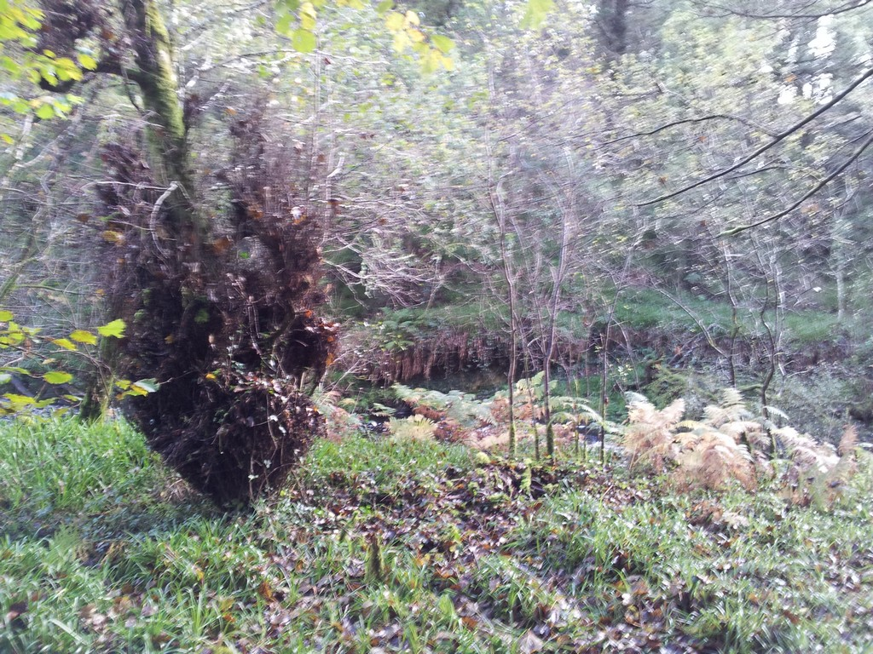

Slide 35
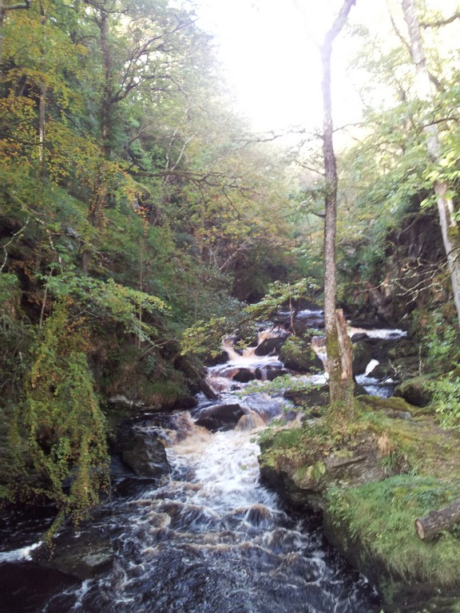

Slide 37
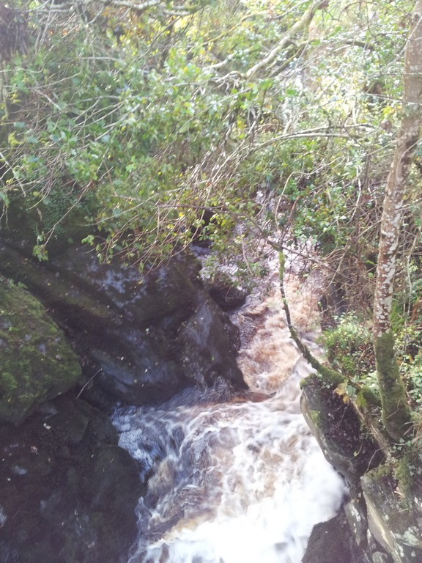

Slide 38
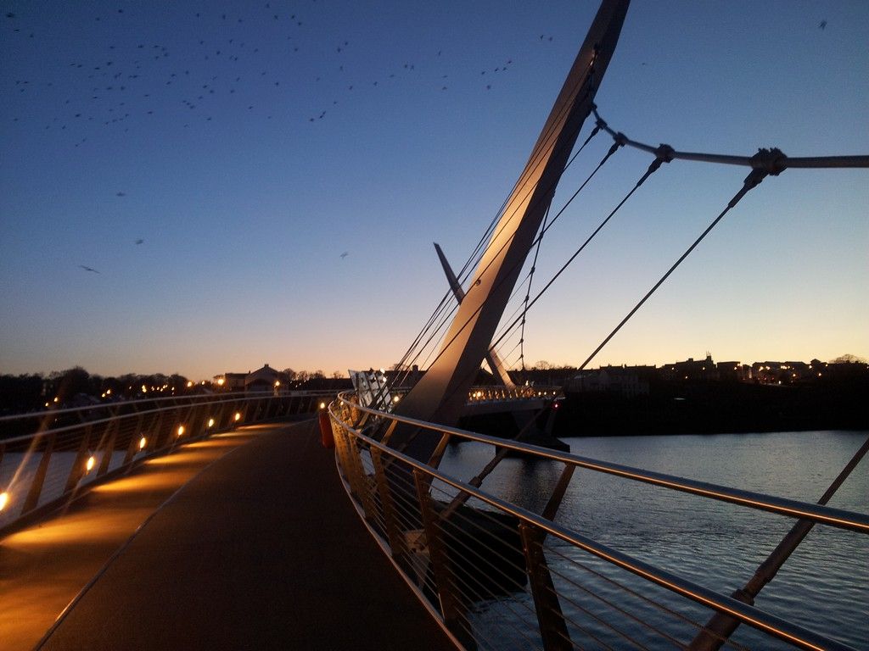

Slide 39
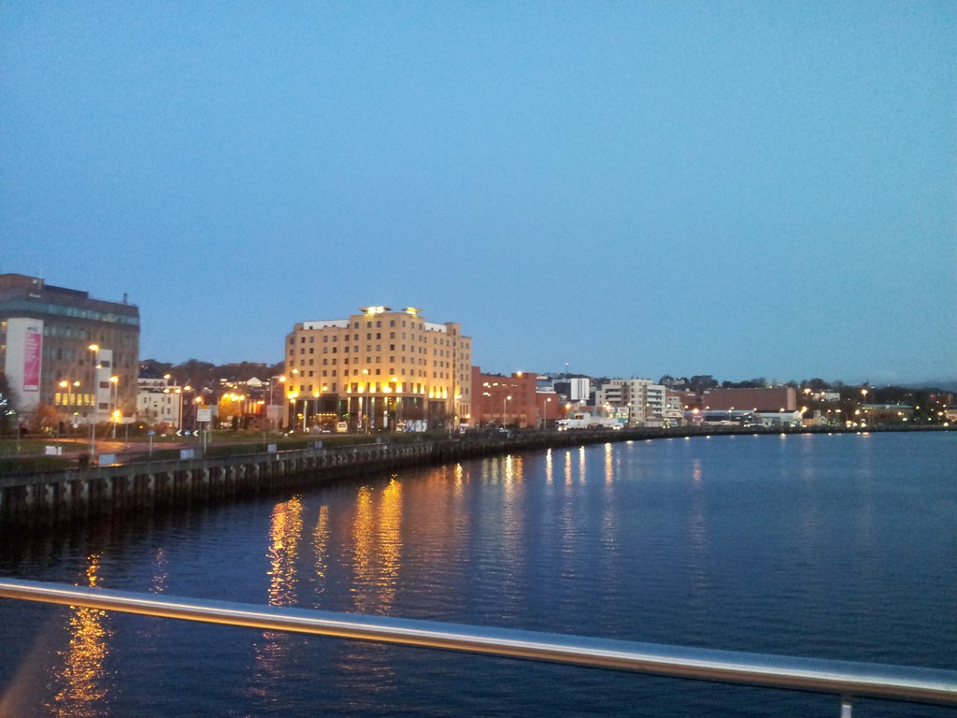

Slide 40

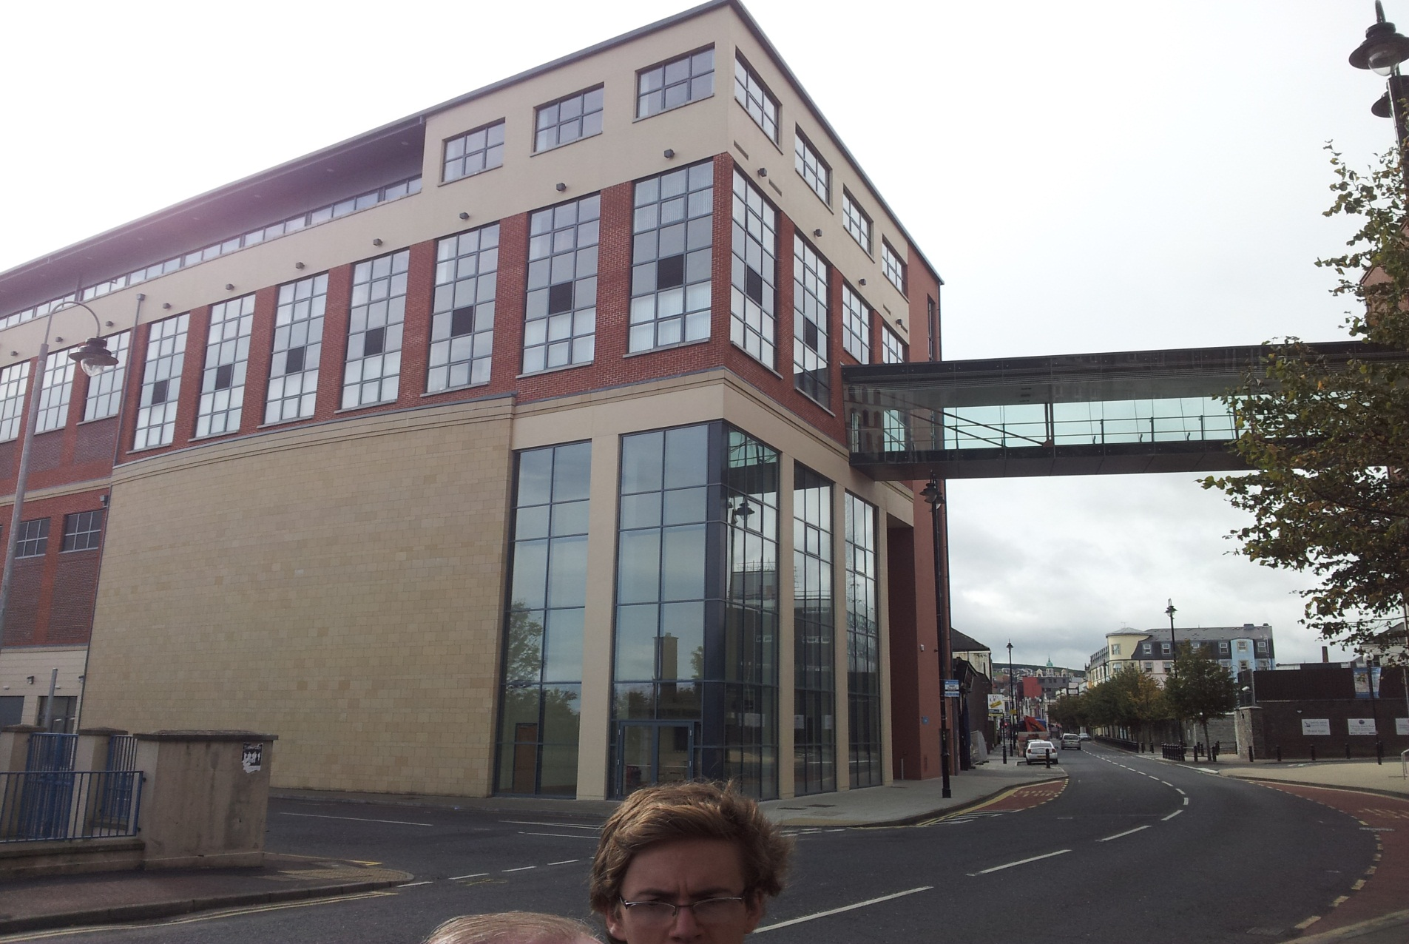
6. The NWRC

Slide 41
Jan
The North West Regional College is a very modern equipped college. Many students are taught there in many different subjects and topics.
Florian, Sergej and me worked in different departments
I was placed in the department „Steps To Work“. The function of this department is to test and qualify unemplyed people to bring them back to work.
The people in this department are great and they received me very friendly. They gave me the feeling that I was part of their community and that was wonderful for me.
Many thanks and greetings at this point to them☺

Slide 42
Sergej
I was placed in the "Students Services" department. The people there are very nice and their work is to help students to get an overview of the college.
Additionally they give advice to the students about courses and organise activities for students.
Furthermore they write useful information in the NWRC Intranet and on their Website.
Willie O‘Donnell is the head of the students services. He is very good at his job and he loves to help people.

Slide 43
Florian
I worked in the “Business Development Department “ with Colm Cavanagh.
The “Business Development Department “ helps people to start their own businesses.
It organizes business training for employees and managers.
My task was to create a database of the local businesses.
The database had, when I left, over 1800 data rows
I categorized the businesses in 30 divisions.
Sometimes I accompanied Colm to meetings.

Slide 44
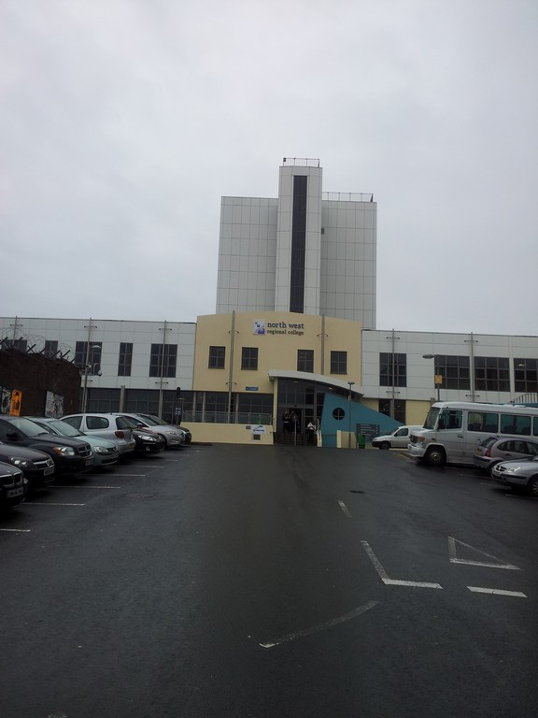

Slide 45
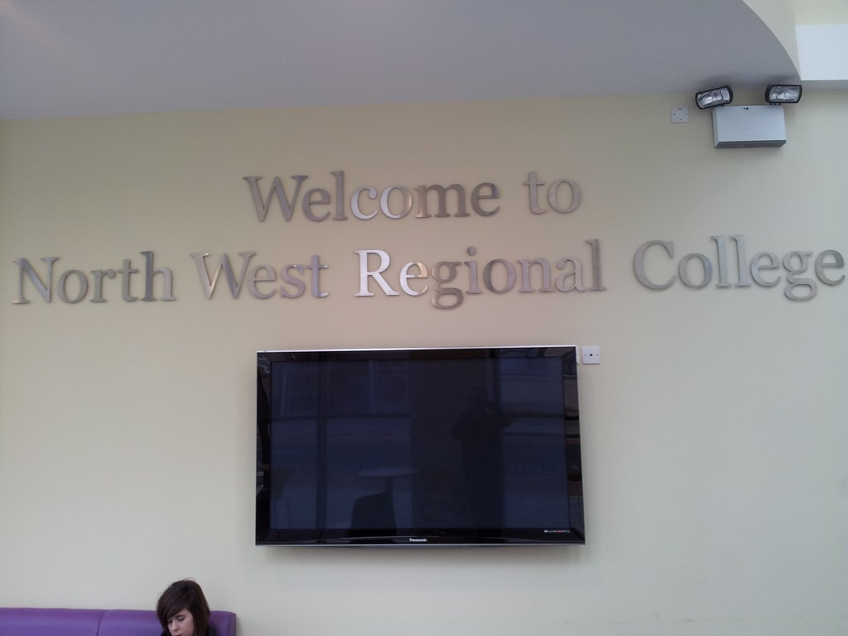

Slide 46
Trip to Dublin
The last two days we made a trip to Dublin because Willie told us, it was a no go to be in (Northern)Ireland without visiting Dublin.
So we went there and we had a very great time there, too
The following pictures show sights of that beautiful city.

Slide 47
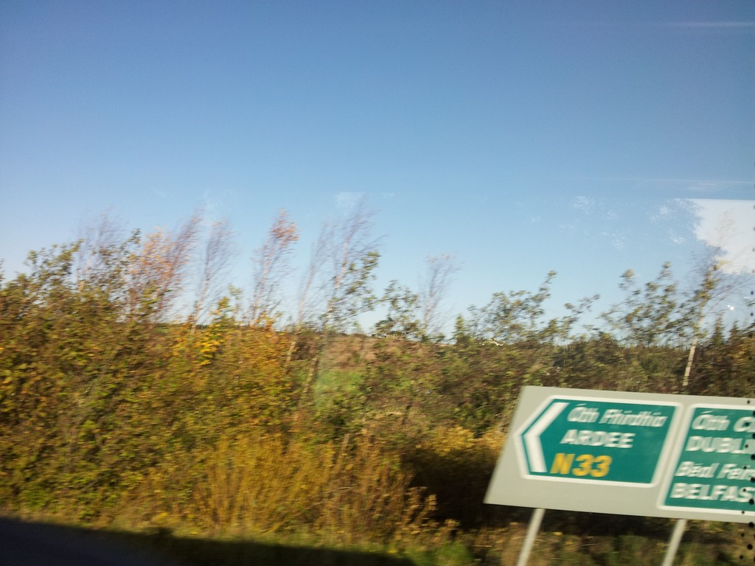

Slide 48
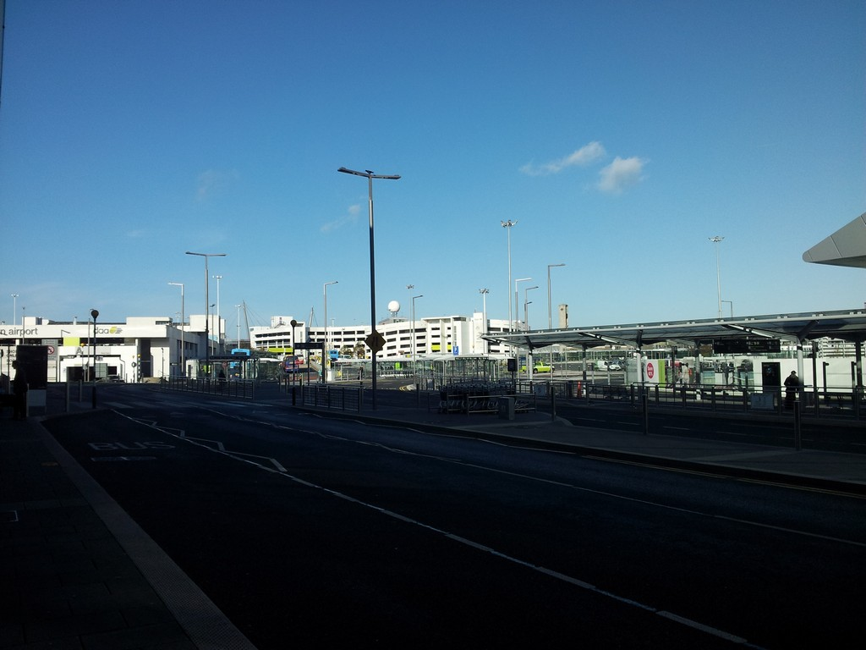

Slide 49
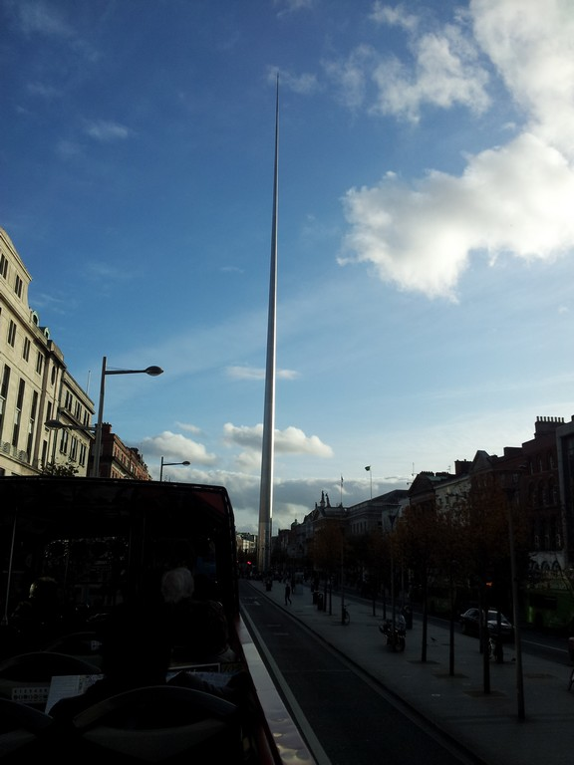

Slide 50
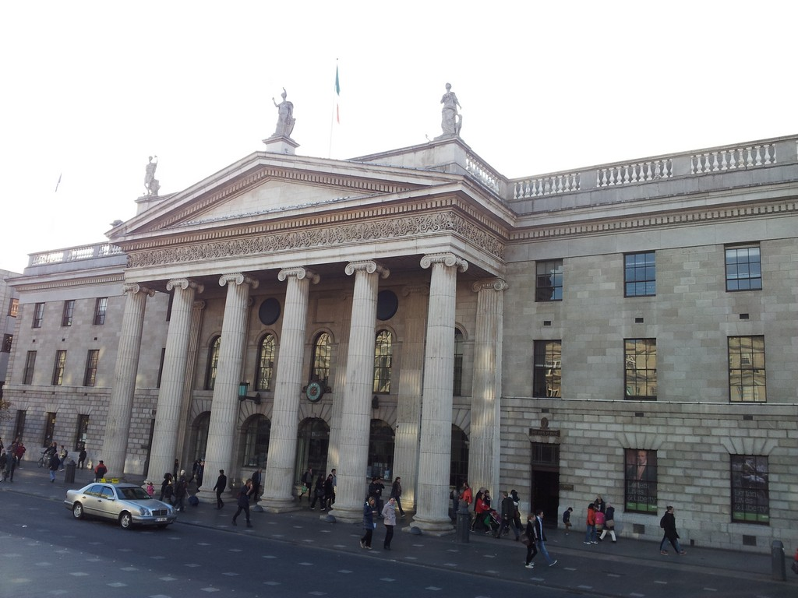

Slide 51
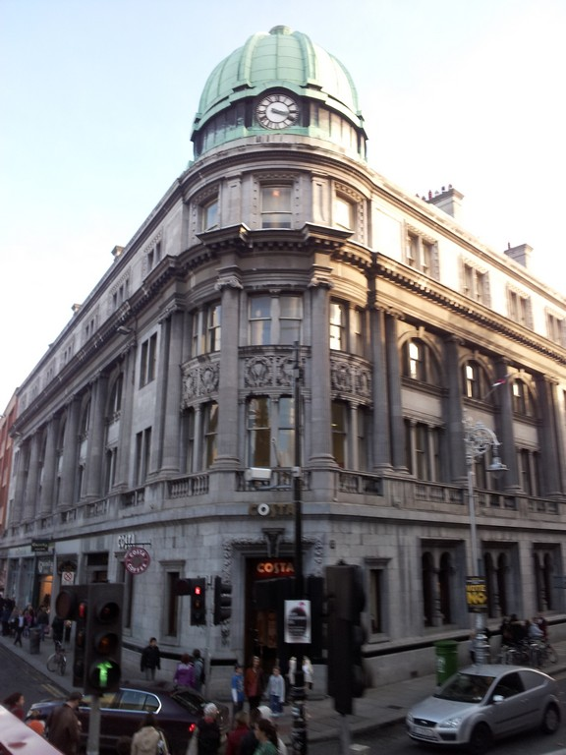

Slide 52
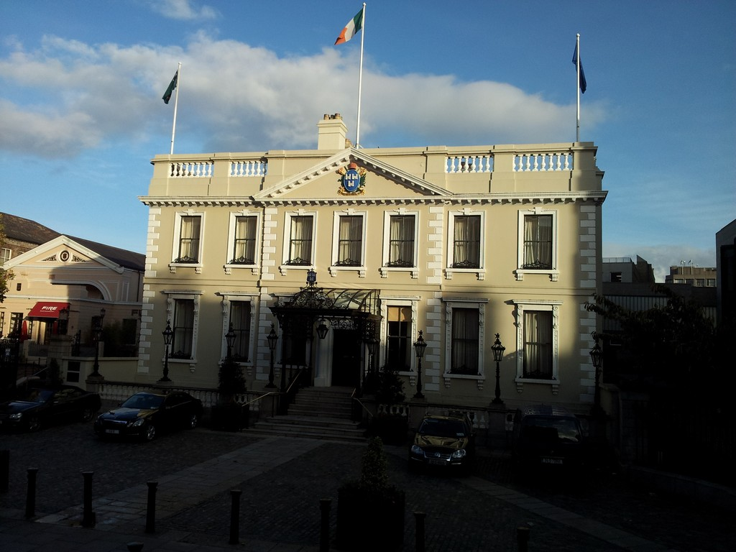

Slide 53
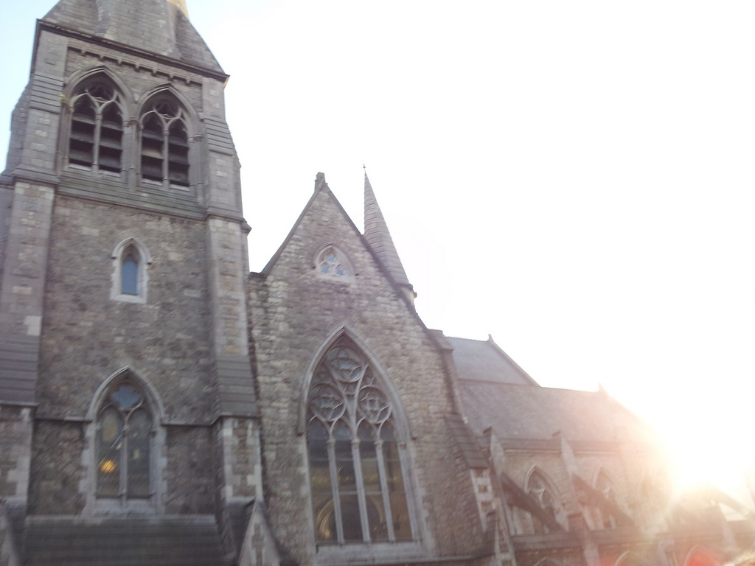

Slide 54
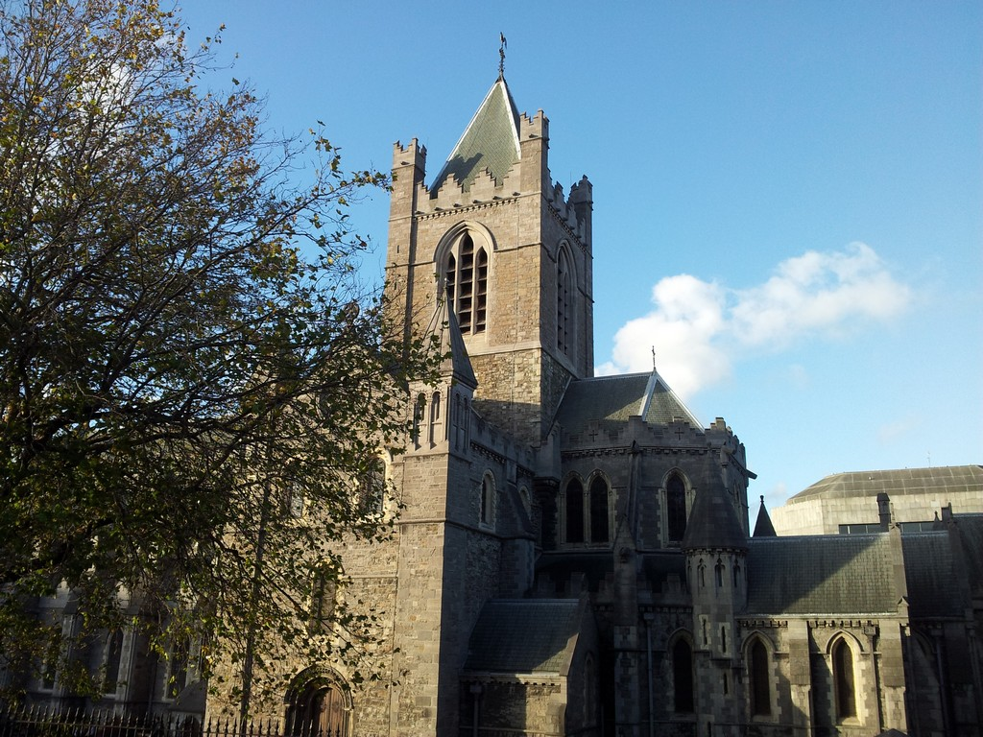

Slide 55
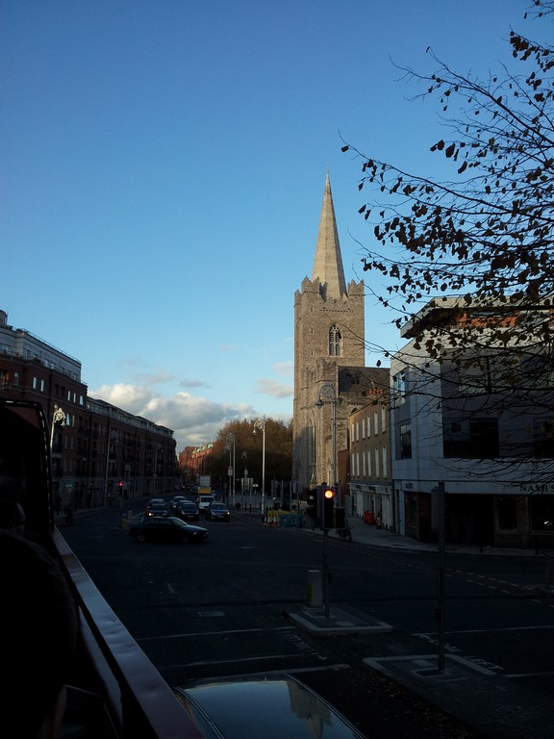

Slide 56
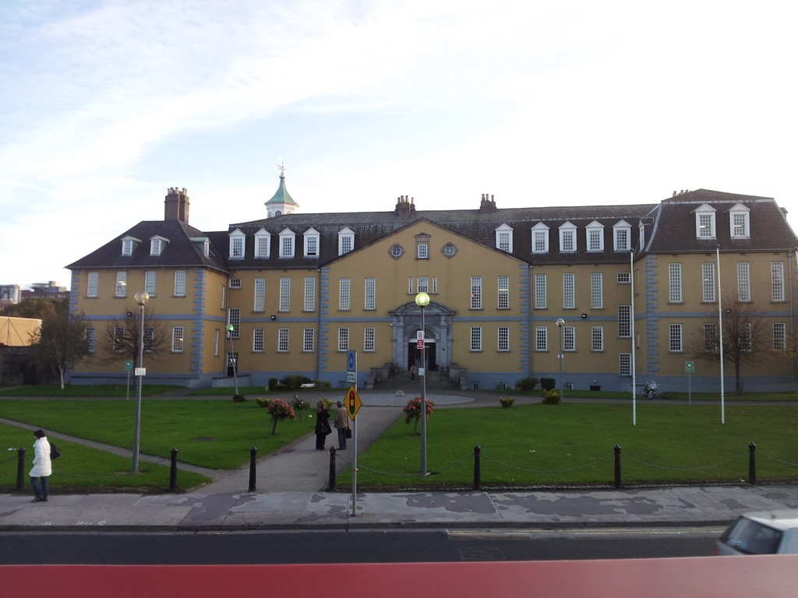

Slide 57
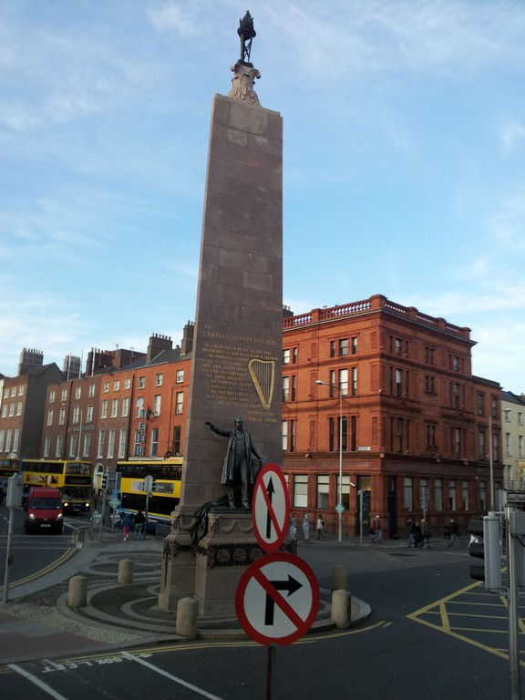

Slide 58
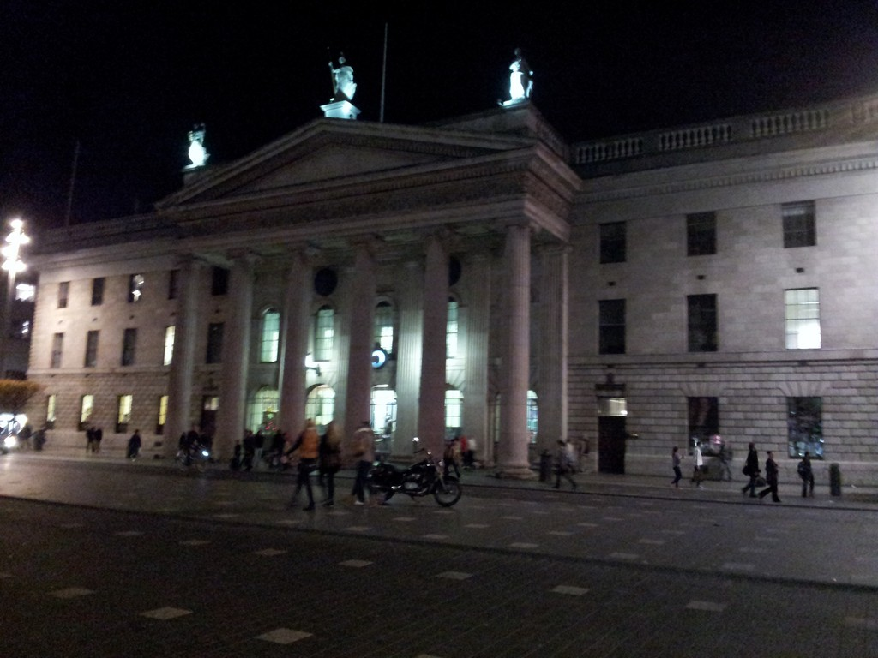

Slide 59
The Guinness Storehouse
Guinness is the only national beer in Ireland. So we went to the Guinness brewery. It was a great experience and the most modern museum, which we have ever visited in our life

Slide 60
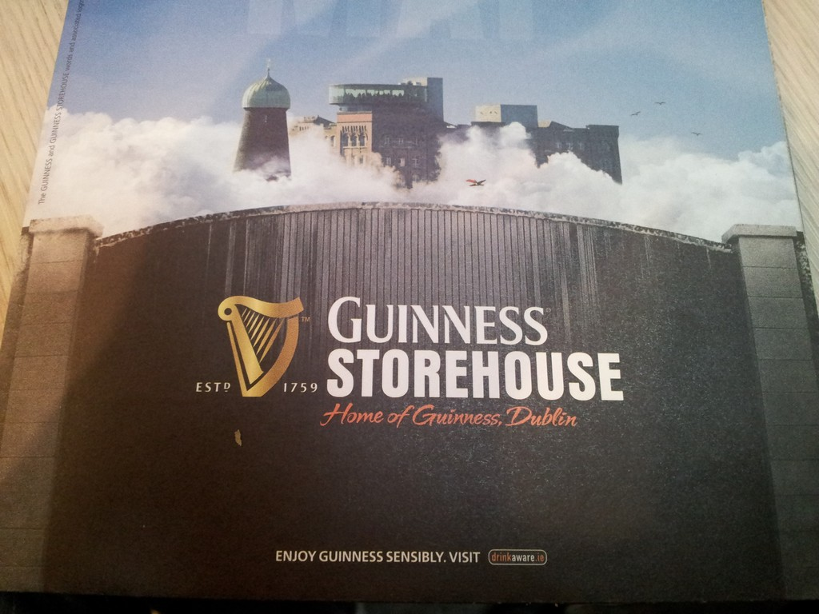

Slide 61
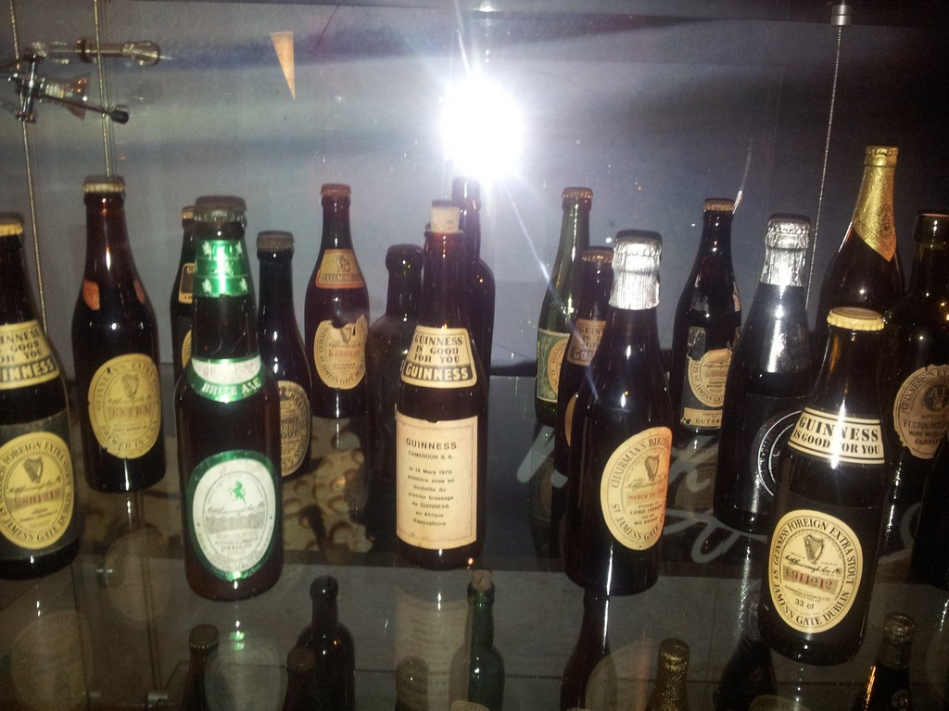

Slide 62
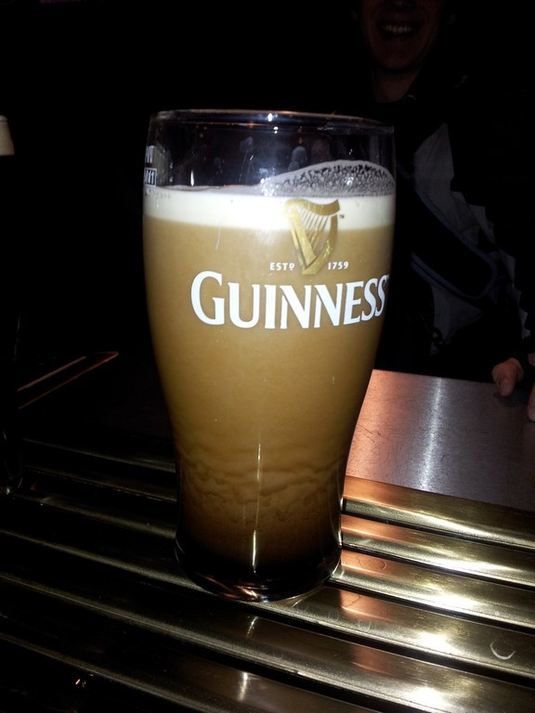

Slide 63
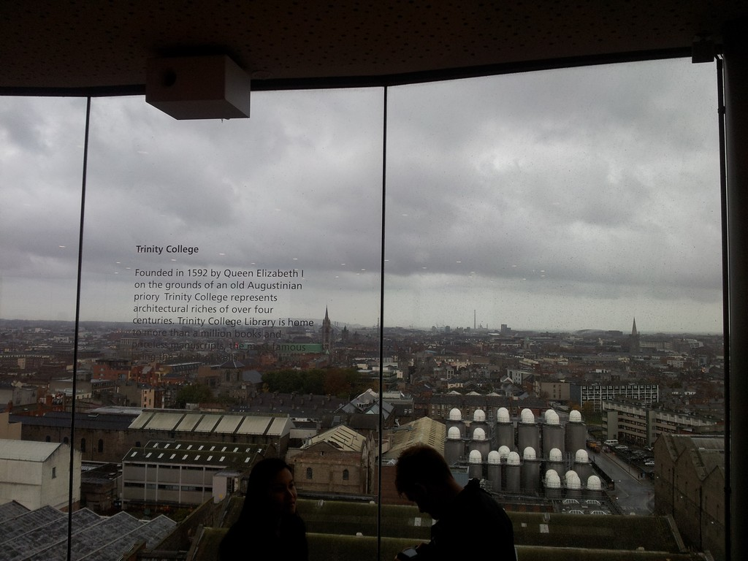

Slide 64
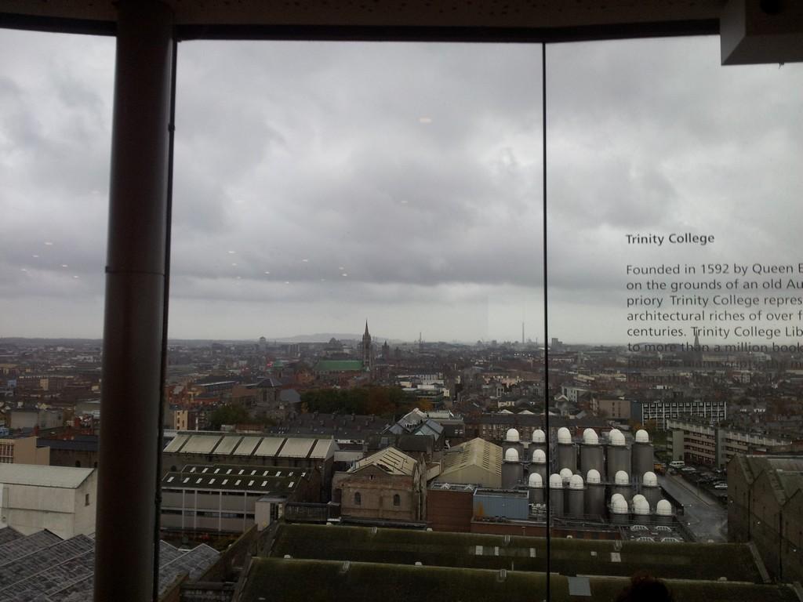

Slide 65


Slide 66
The End
Thank you for watching.
We hope you enjoyed it and feel invited to visit that beautiful country, too.
We would like to encourage all our fellow students to also take part in such an experience, which was unique for us.
We're looking forward to visit Derry/Londonderry and Dublin again in a few years.

